Slide 1

Notes:
Hello, I’m Niki Barolini, art director and science visualizer in the office of communications.
My talk today will focus on Developing Scientific Figures & Journal Covers.

Slide 2
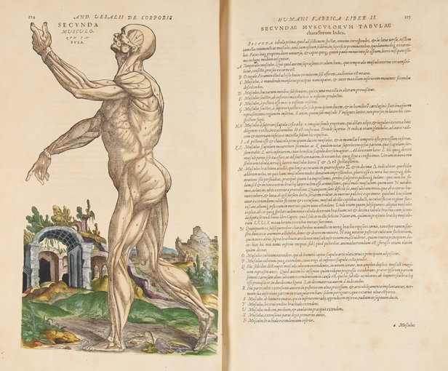
Artists have depicted
medical advances
and health practices
throughout history.
Notes:
Most everyone recognizes that illustrations and graphics are an invaluable factor in clearly presenting ideas.
Its not news that artists and physicians have always shared a close working relationship--they needed each other to make sense of the intricate workings of our bodies.

Slide 3
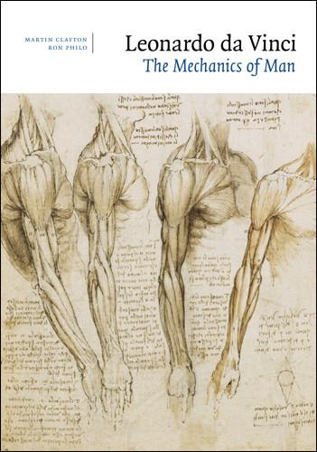
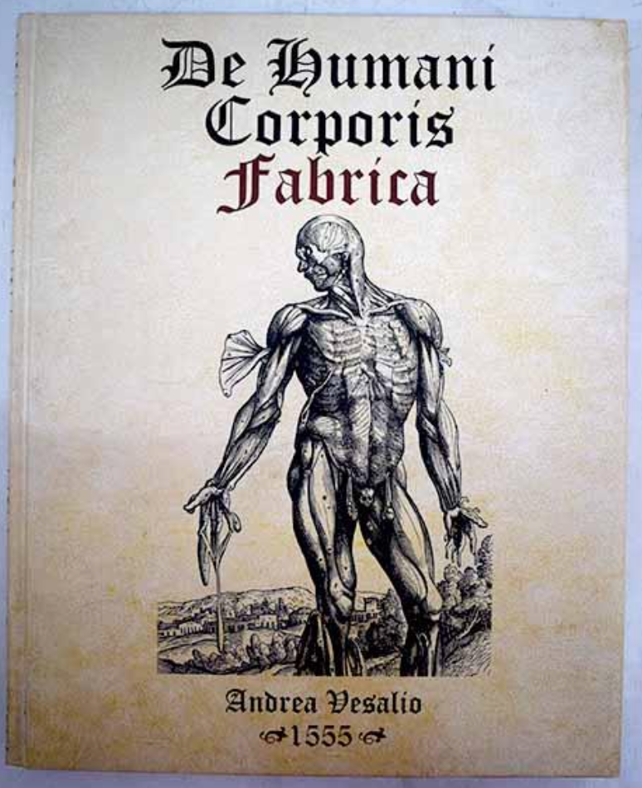

Leonardo
Da Vinci
Andreas Vesalius
Frank
Netter
Notes:
Often physicians were also artists, or artists who also practiced medicine…
icons such as Leonardo Davinci, Andreas Vesalius and Frank Netter

Slide 4
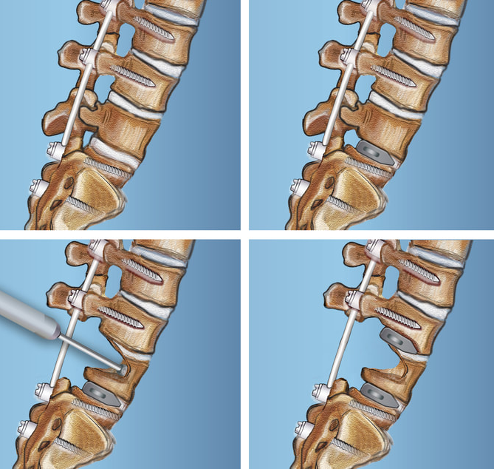
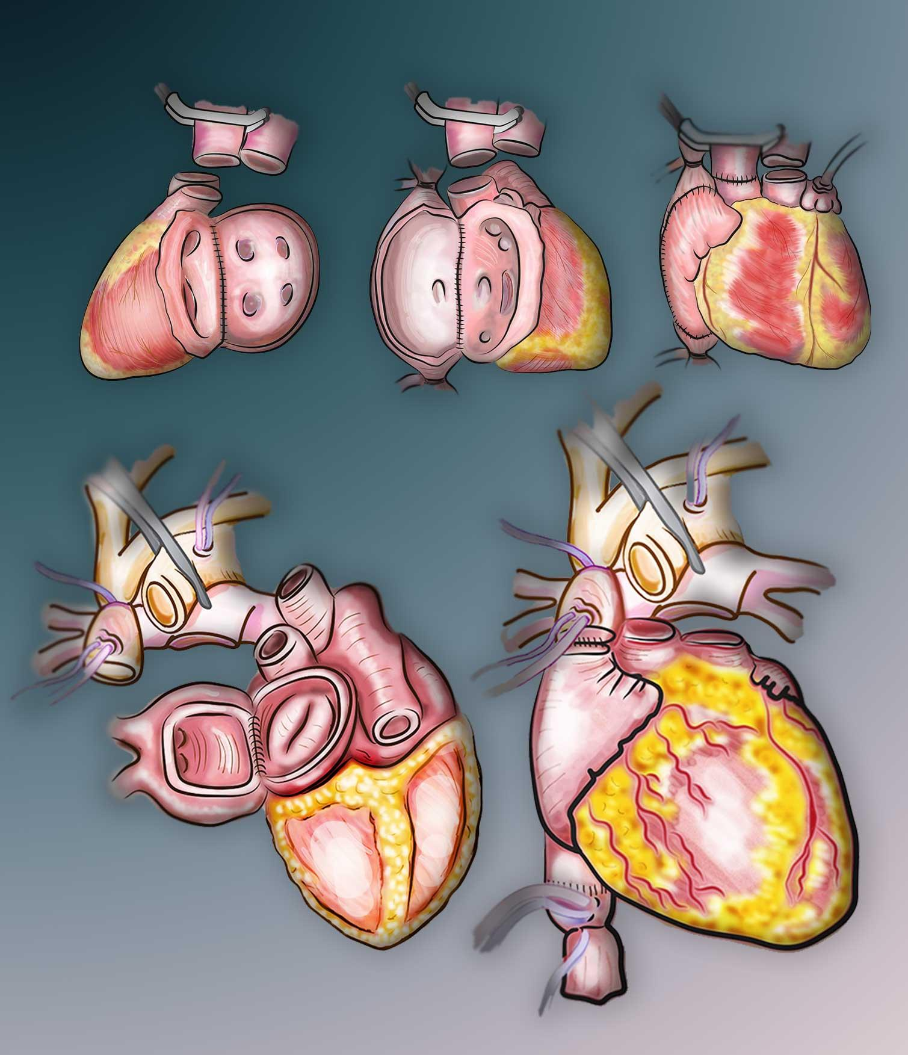
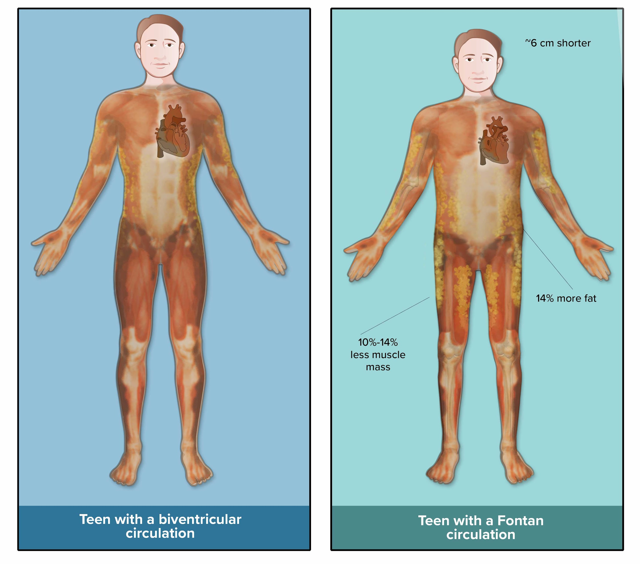
Notes:
Unlike those icons, I’m not a physician---I did take a year of pre-med in college and I soon found out that I am a much better artist than I would have been a doctor! After college I got a job as a graphic designer and illustrator with the medical publisher Raven Press.
Now, I create graphics and science illustrations at Columbia where I have been working for the last 16 years.

Slide 5
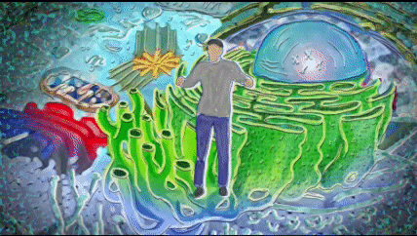
► Audience
► Context
► Path
► Actors
► Clarity
Notes:
But often scientist have to create their own images,
so are some basic things to consider when creating research images and other science art:
Audience
Context
Path
Actors
Clarity

Slide 6

Who is your audience?
How familiar is your audience with the subject matter?
What’s your desired outcome?
► Audience
Notes:
Here are some questions to ask yourself:
Who is your audience?
How familiar is your audience with the subject matter?
What’s your desired outcome?

Slide 7

► Context
front cover
back cover
content
Notes:
Context is how content is packaged.
For example, think of a book, it has a front cover and a back cover and in between is the subject matter.
Well, the same is true for a graphic, it has an entry point and an exit point and in between is the important content.

Slide 8


Simple
Complex
Sweet Spot
Notes:
It is not an easy task for a scientist to simplify or reduce complex research. Finding the sweet spot can be difficult, because there is the possibility of either being too simplistic for experts, or too complex for the general public.

Slide 9

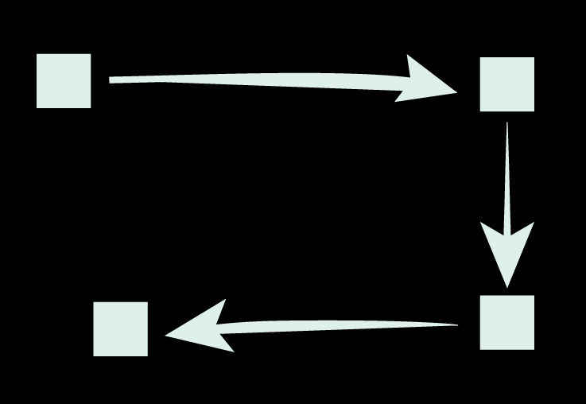

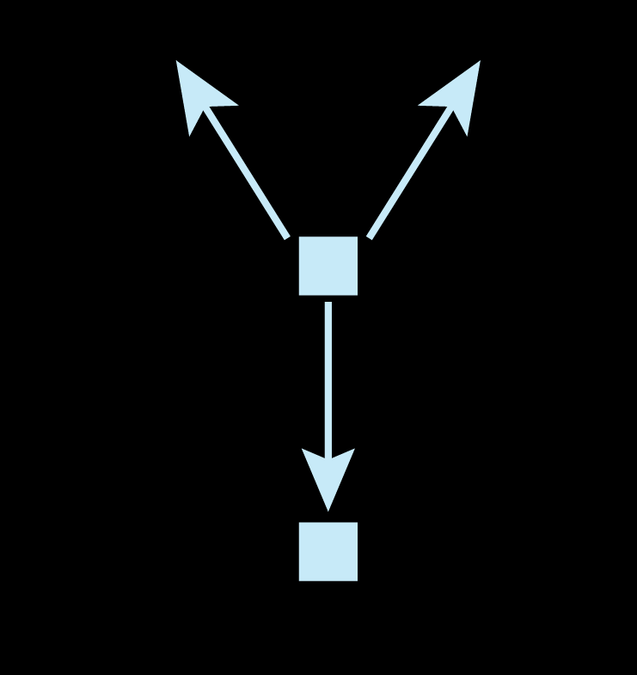
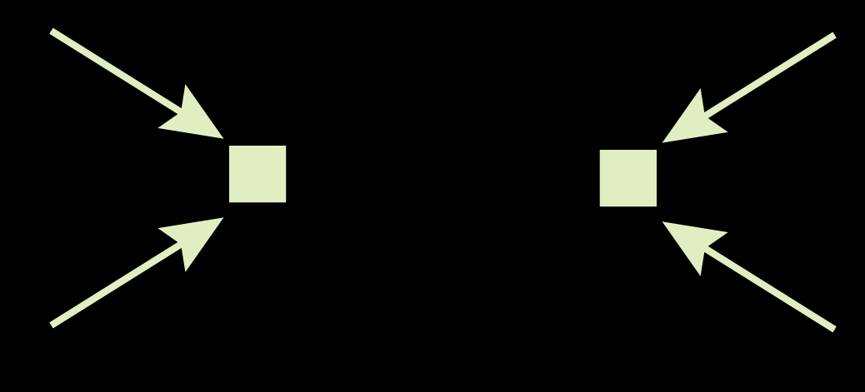
Linear
► Path
Serpentine
Circular
Convergent
Radiating
Notes:
As in a book, there is a narrative, or a distinct path from entry to exit point.
Clear paths are crucial for directing the flow of information.
Here are a few examples of common paths:

Slide 10
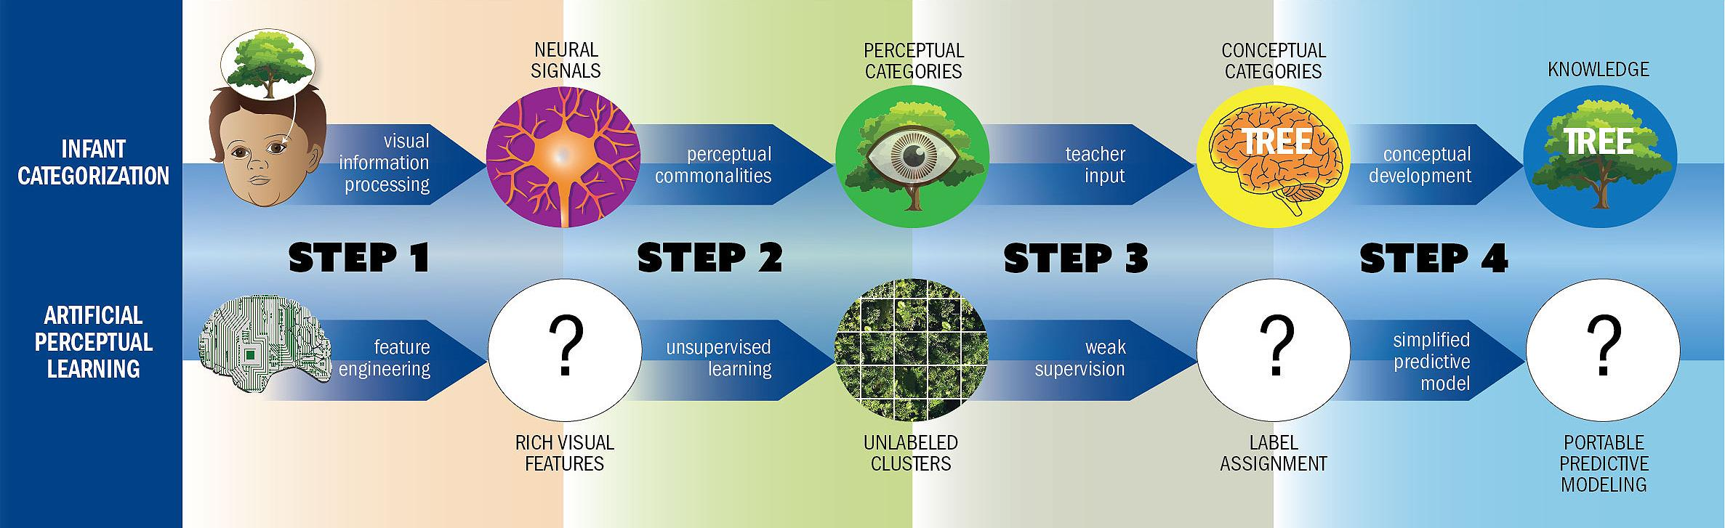
Example of a linear path
► Path
Linear
Serpentine
Divergent
Circular
Radiating
Notes:
Here’s example of a linear graph: The entry point is on the left, were the viewer is then guided linearly through the process in a logical manner.

Slide 11
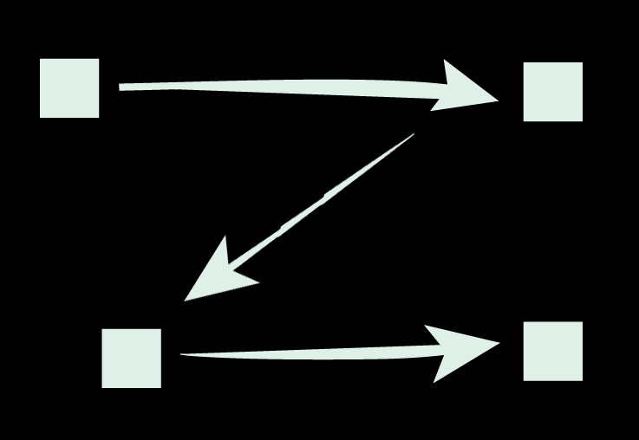
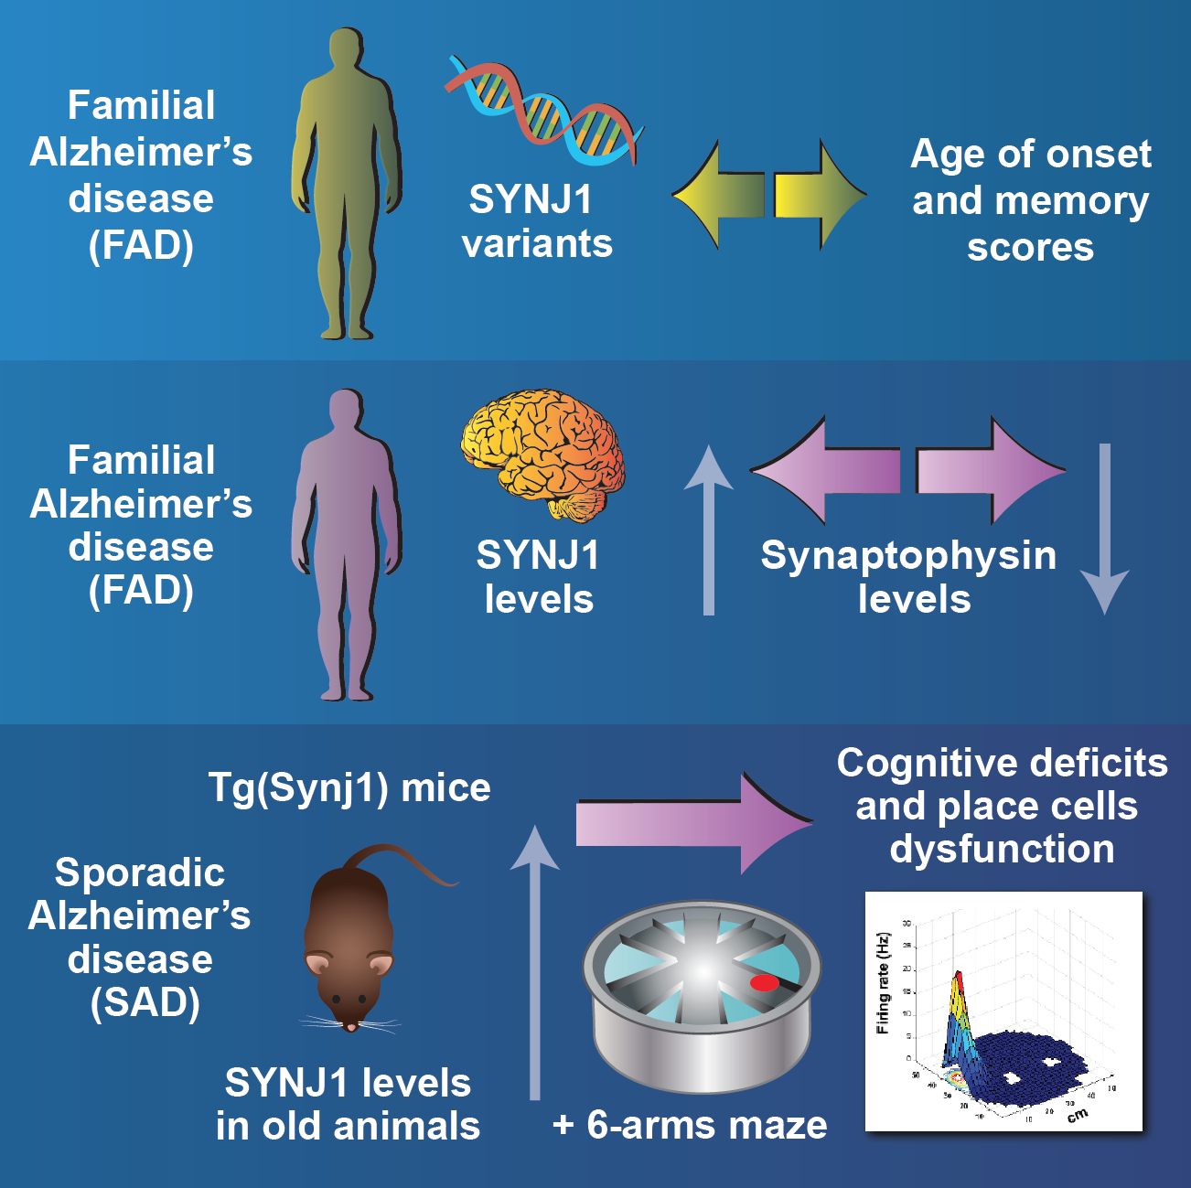
Example of a serpentine path
► Path
Linear
Serpentine
Divergent or Convergent
Circular
Radiating
Notes:
This is a serpentine path because the information zig-zags from entry point on the top left to the exit on the bottom right

Slide 12
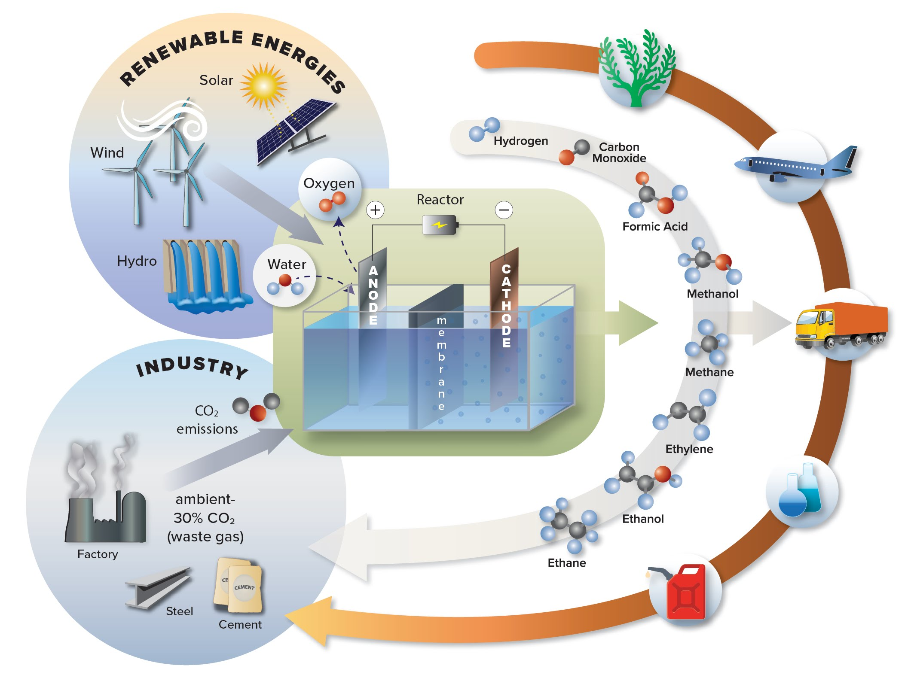
Example of a convergent path
► Path
Linear
Serpentine
Convergent
Circular
Radiating
Notes:
A convergent path forms a triangulation

Slide 13

Example of a circular path
► Path
Linear
Serpentine
Divergent
Circular
Radiating
Notes:
A circular path

Slide 14
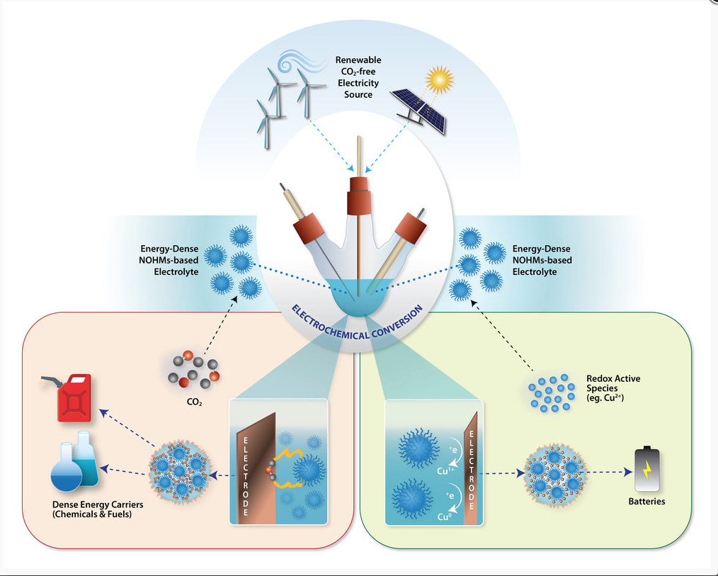
Example of a radiating path
► Path
Linear
Serpentine
Divergent
Circular
Radiating
Notes:
And finally a Radiating path
Naturally, multiple paths can be combined into one graphic. This one has both radiating and circular paths.

Slide 15
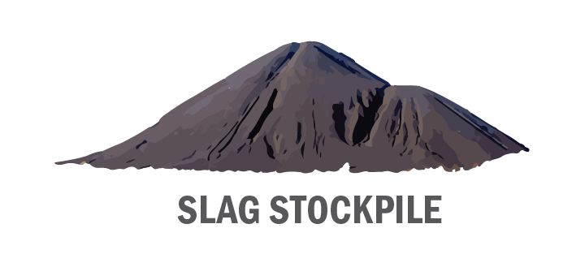
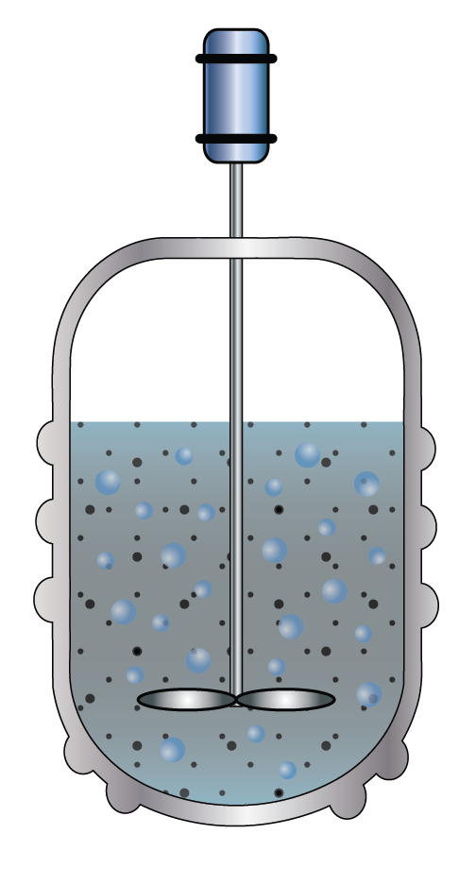

► Actors
Villain
Star
Batch Reactor
Co-Star
Notes:
The next thing to consider are the actors. Who is this story about, who are the ‘players’ that will travel along the path?
Just like real movie actors, who is the star? The co-star? The extras? (Is there a villain...?!) And what is the relationship between the actors?
In this example the batch reactor is the hero who will eliminate the polluting iron slag waste

Slide 16
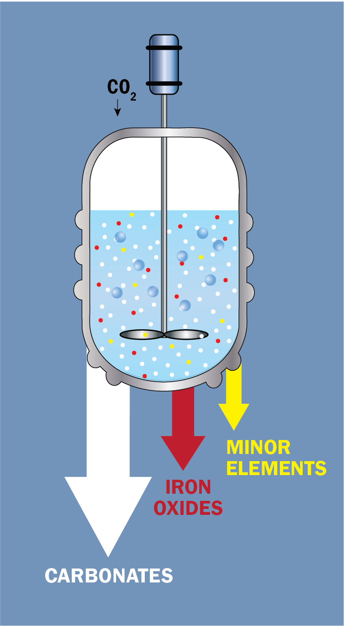
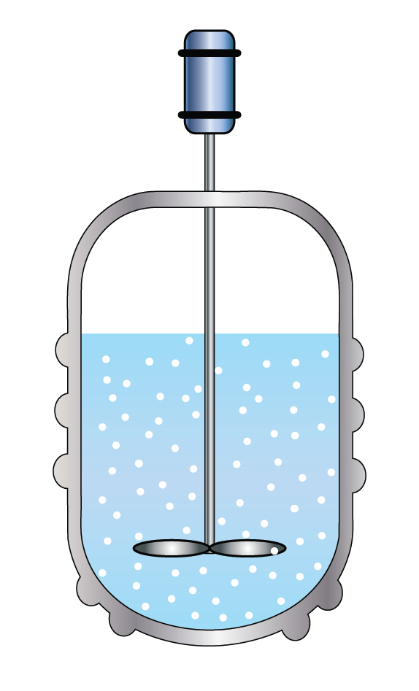
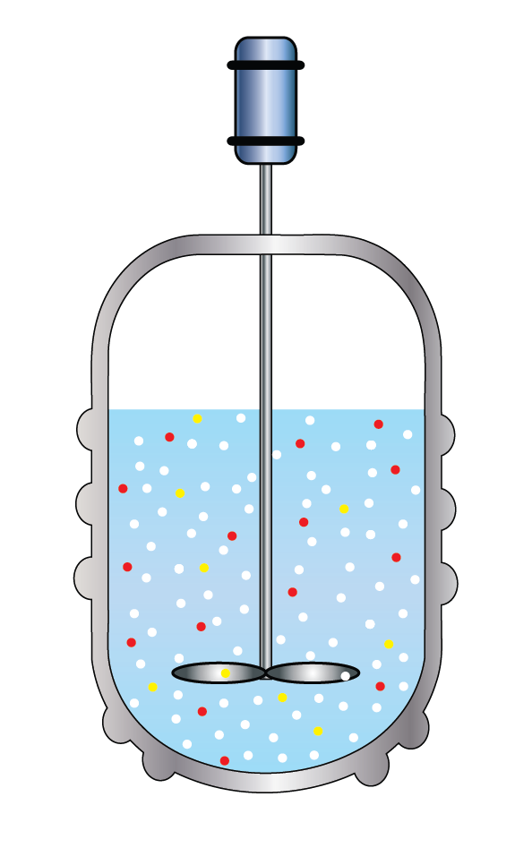
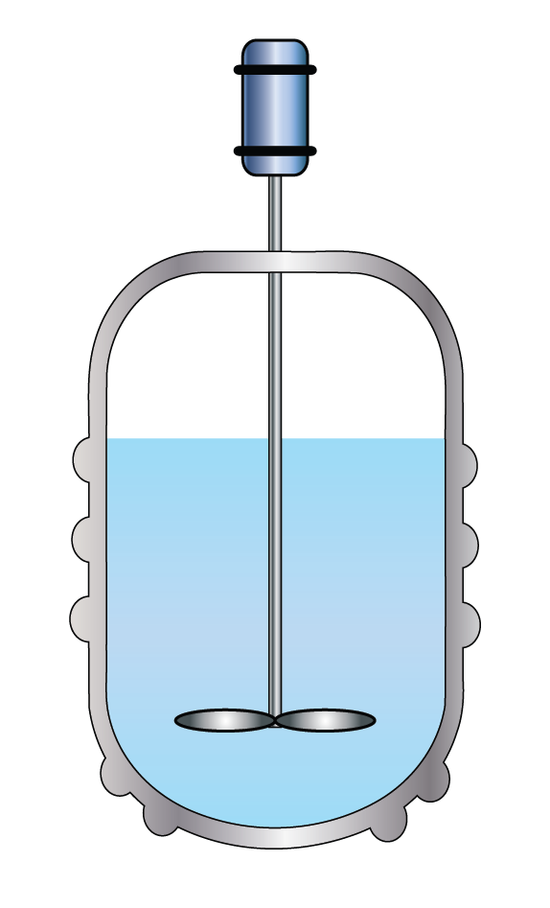
► Clarity
Colors are not used superfluously, but to give
clarity to the material
Notes:
Last but not least, clarity is achieved by not adding extra clutter to the diagram, strong graphics are clean. This doesn’t mean that the image should be stark, but rather that each element should have a distinct purpose and not be superfluous. Shapes, colors, patterns, and fonts should be used to drive the message along the path and not just to be pleasing to the eye.
In the next few slides I will show ‘before and after’ examples. On the left of the slides are sketches or doodles that I received from Columbia researchers and faculty and the final illustrations will be on the right.

Slide 17

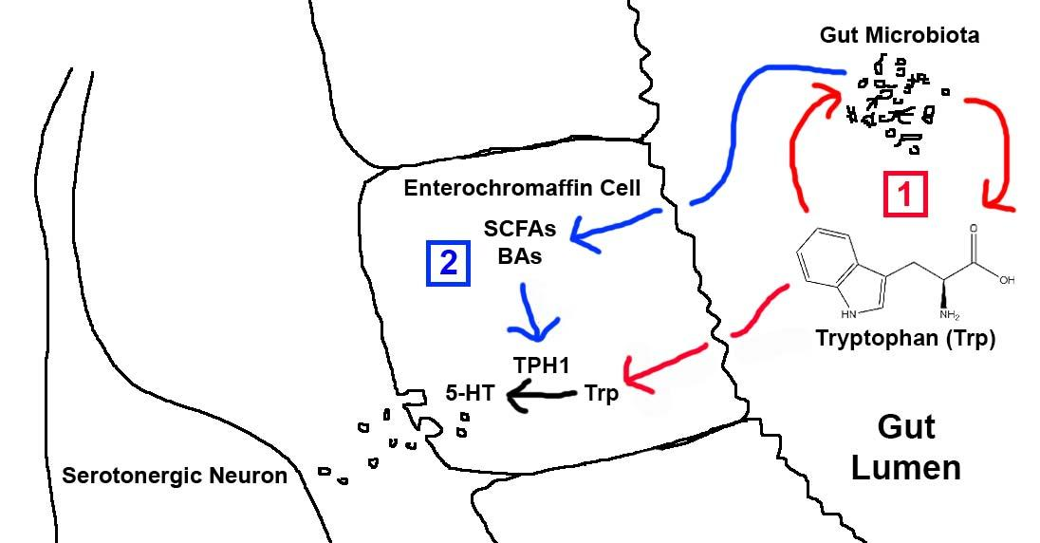
Grant submission figure
Daniel Freedberg, MD, MS
Herbert Irving Assistant Professor of Medicine and Epidemiology
Columbia University, Division of Digestive & Liver Diseases
Mailman School of Public Health, Department of Epidemiology
Notes:
This first example features a very detailed sketch done by Dr. Freedberg for a grant submission figure.
This would be considered an example of a simple graphic, because the foundational elements for this graphic are already
all mapped out, it only needed to be augmented with color, shading and detail.
By adding those elements the visual impact and legibility increased.

Slide 18
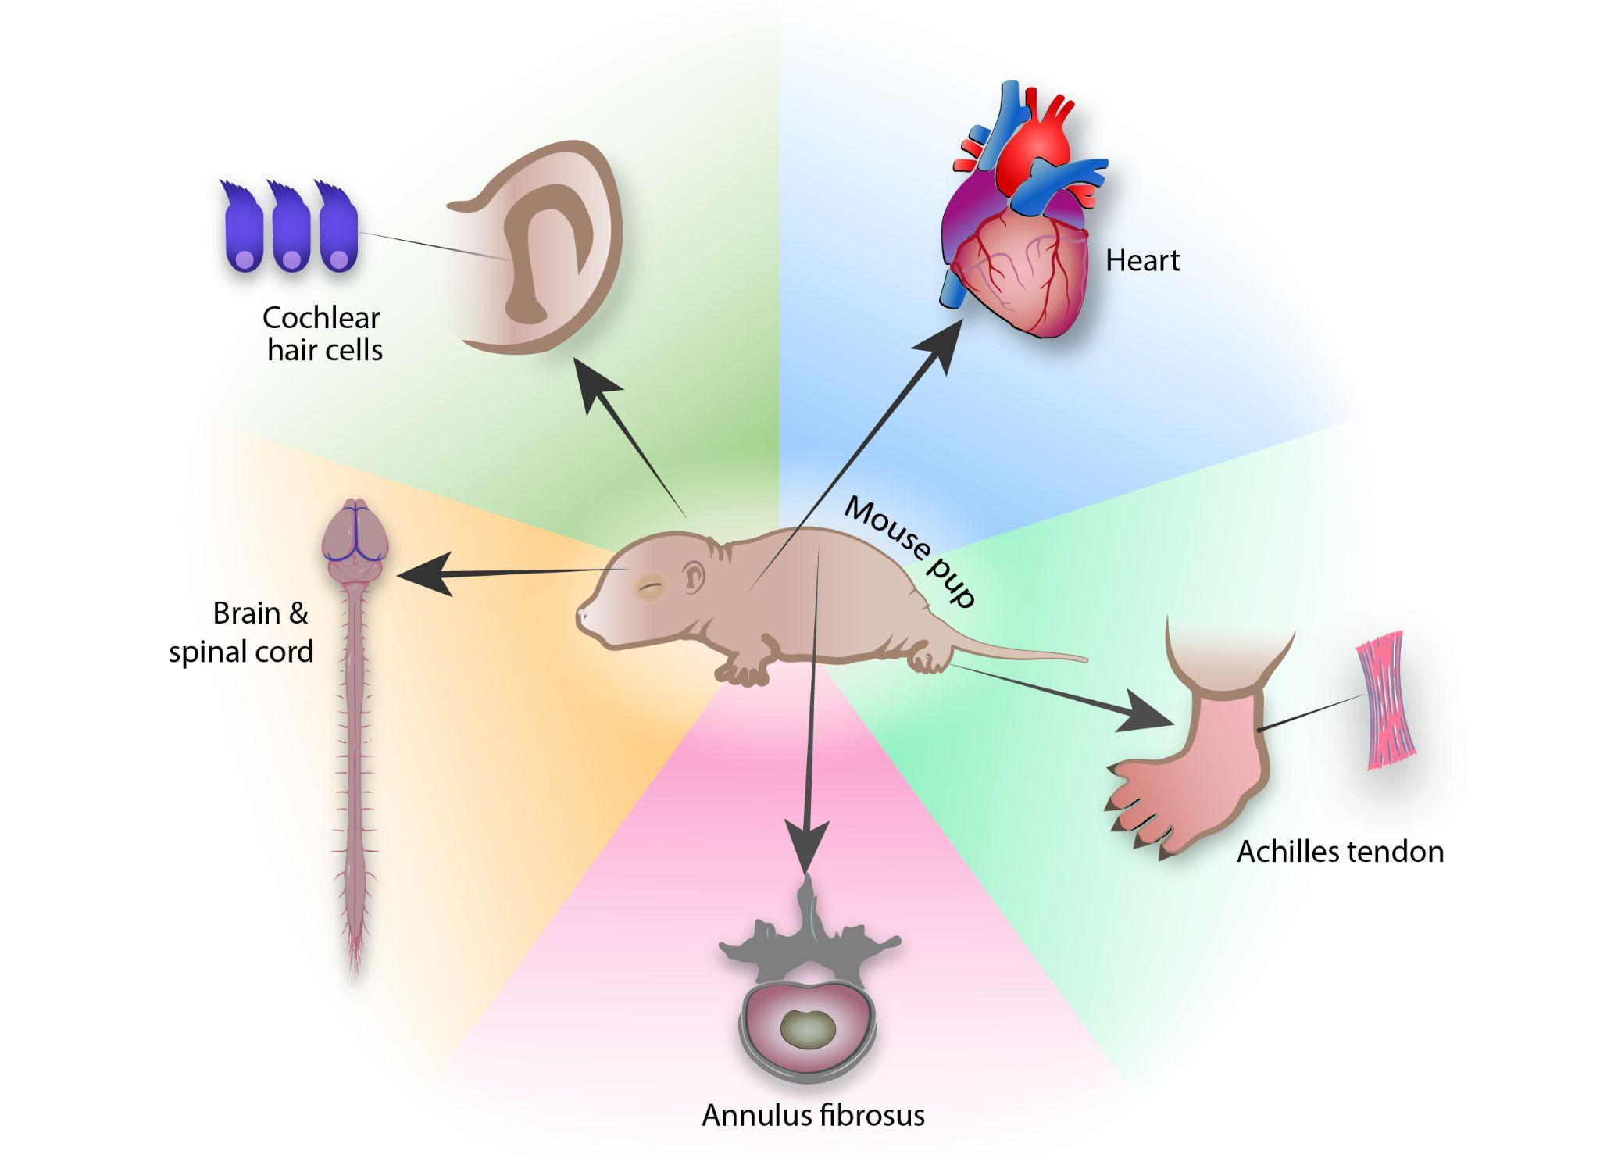
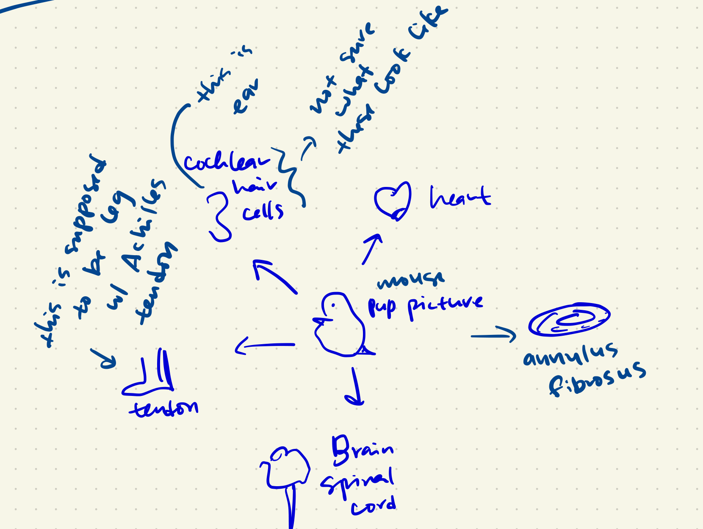
Review article figure
Alice Huang
Associate Professor
Dept of Orthopedic Surgery
Notes:
Here is another example of a detailed sketch for a review article.
Although the hand writing was difficult to read in places, I was also given typewritten instructions to follow which streamlined the execution.
In this circular path image adding the multicolored background served to differentiate and highlight the mouse pup’s body parts

Slide 19
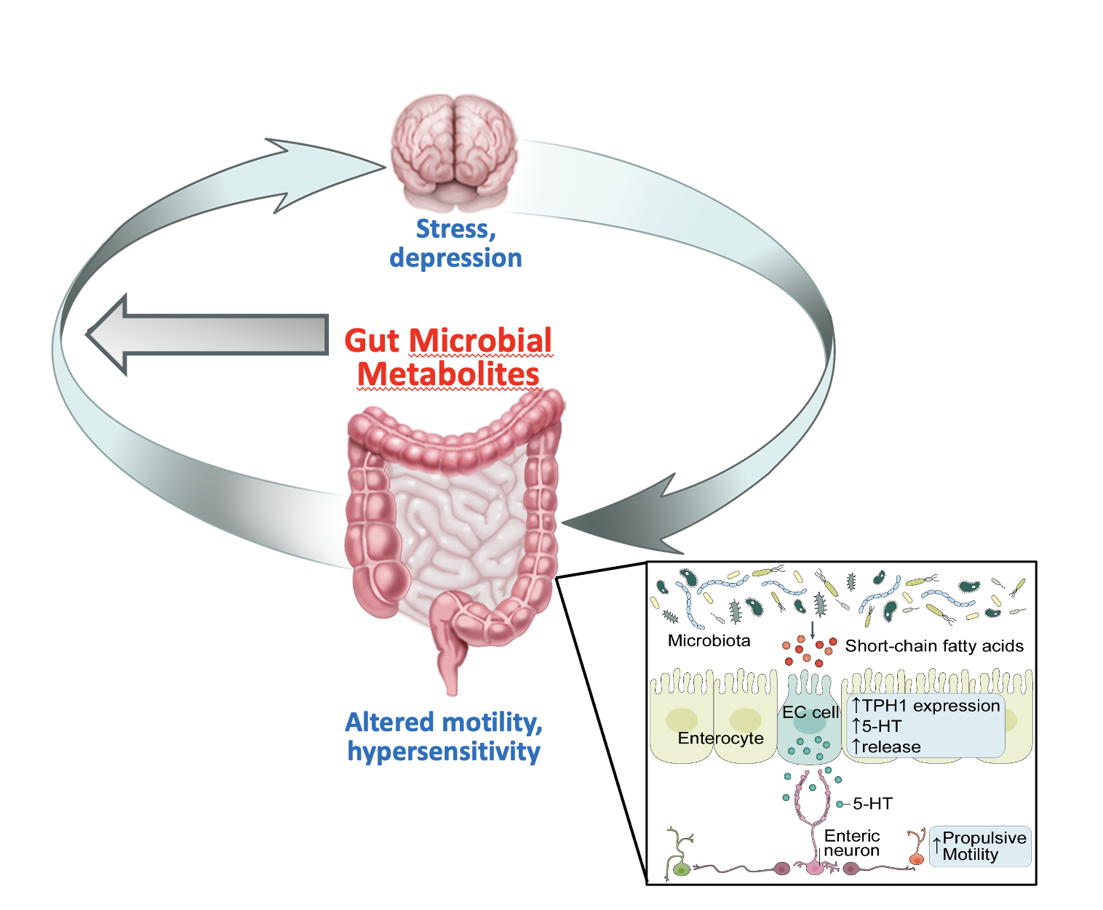

COVID IBS figure
Daniel Freedberg, MD, MS
Herbert Irving Assistant Professor of Medicine and Epidemiology
Columbia University, Division of Digestive & Liver Diseases
Mailman School of Public Health, Department of Epidemiology
Notes:
Here is an example of a sketch done using Biorender icons—
Biorender, for those who don’t know, is a website that offers pre-made icons and templates from all fields of life sciences.
And here is the final illustration I created from it.
A few of the changes I made were to:
add a human so that the organs aren’t just floating
Enlarge the call out window from the intestines
And add information to the arrow giving it more visual functionality
It may not seem so at first glance, but the basic structure is a circular path

Slide 20
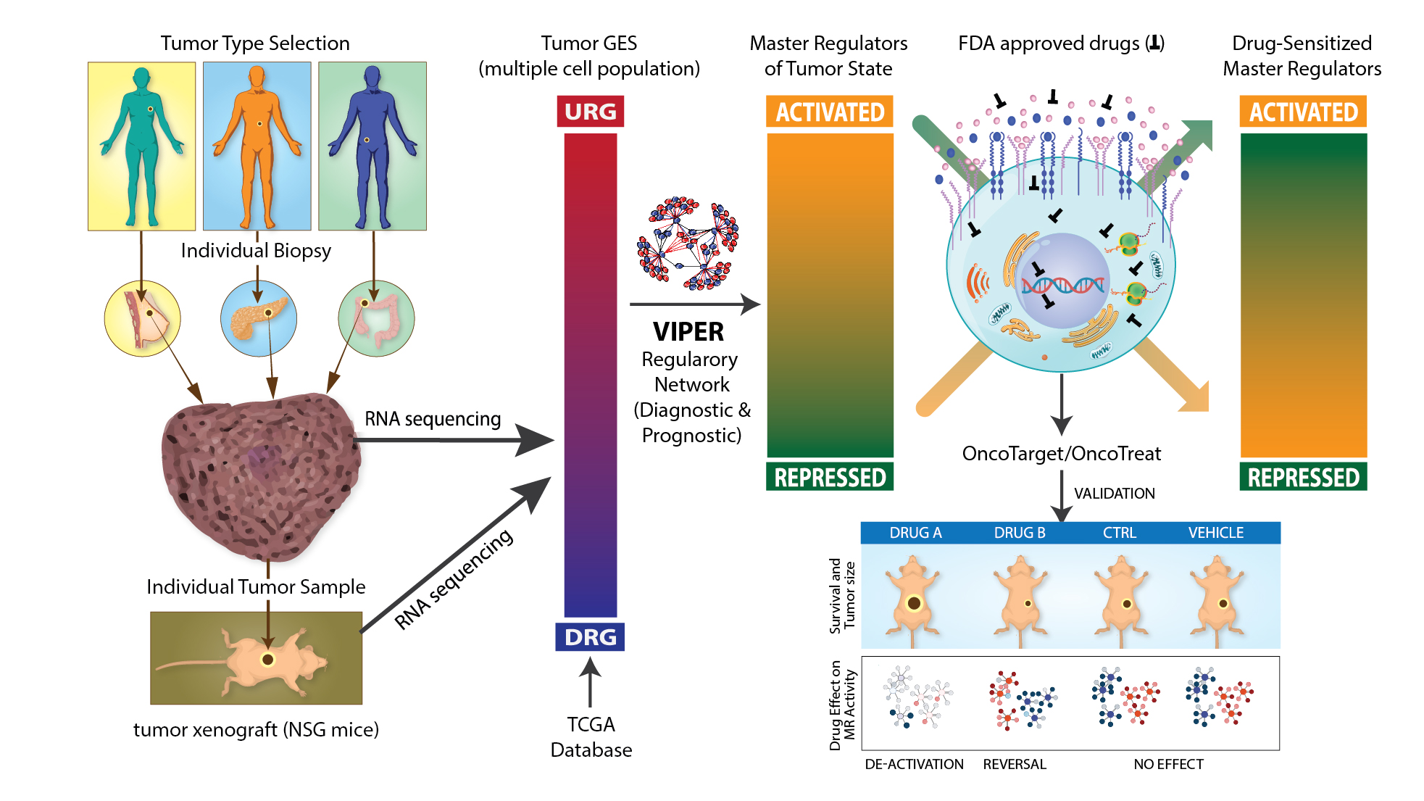
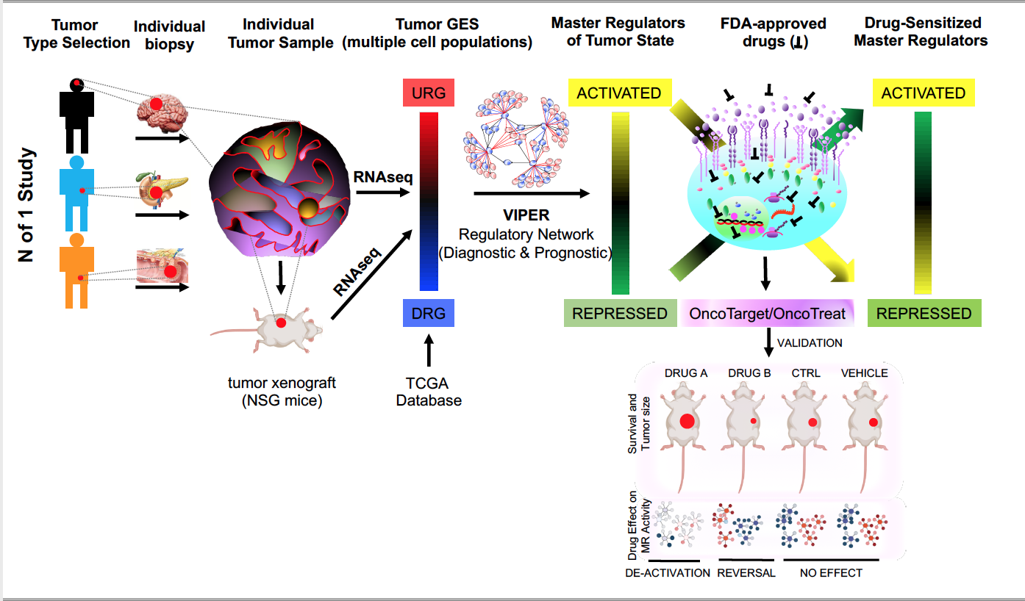
Cell Journal figure
Dr. Andrea Califano,
Prof. Chemical and Systems Biology
Notes:
Here is an example of a research figure for publication in the journal Cell that required visual editing and polishing.
And this is the finished illustration
The flow and legibility of the of the figure are improved by re-organizing the direction of the first column to flow from top down and by visually balancing the other elements in order to present information clearly in an eye-catching way.
The scope, of course, is to enhance the understanding of the viewer, not make it more confusing.
This uses convergent and linear paths

Slide 21

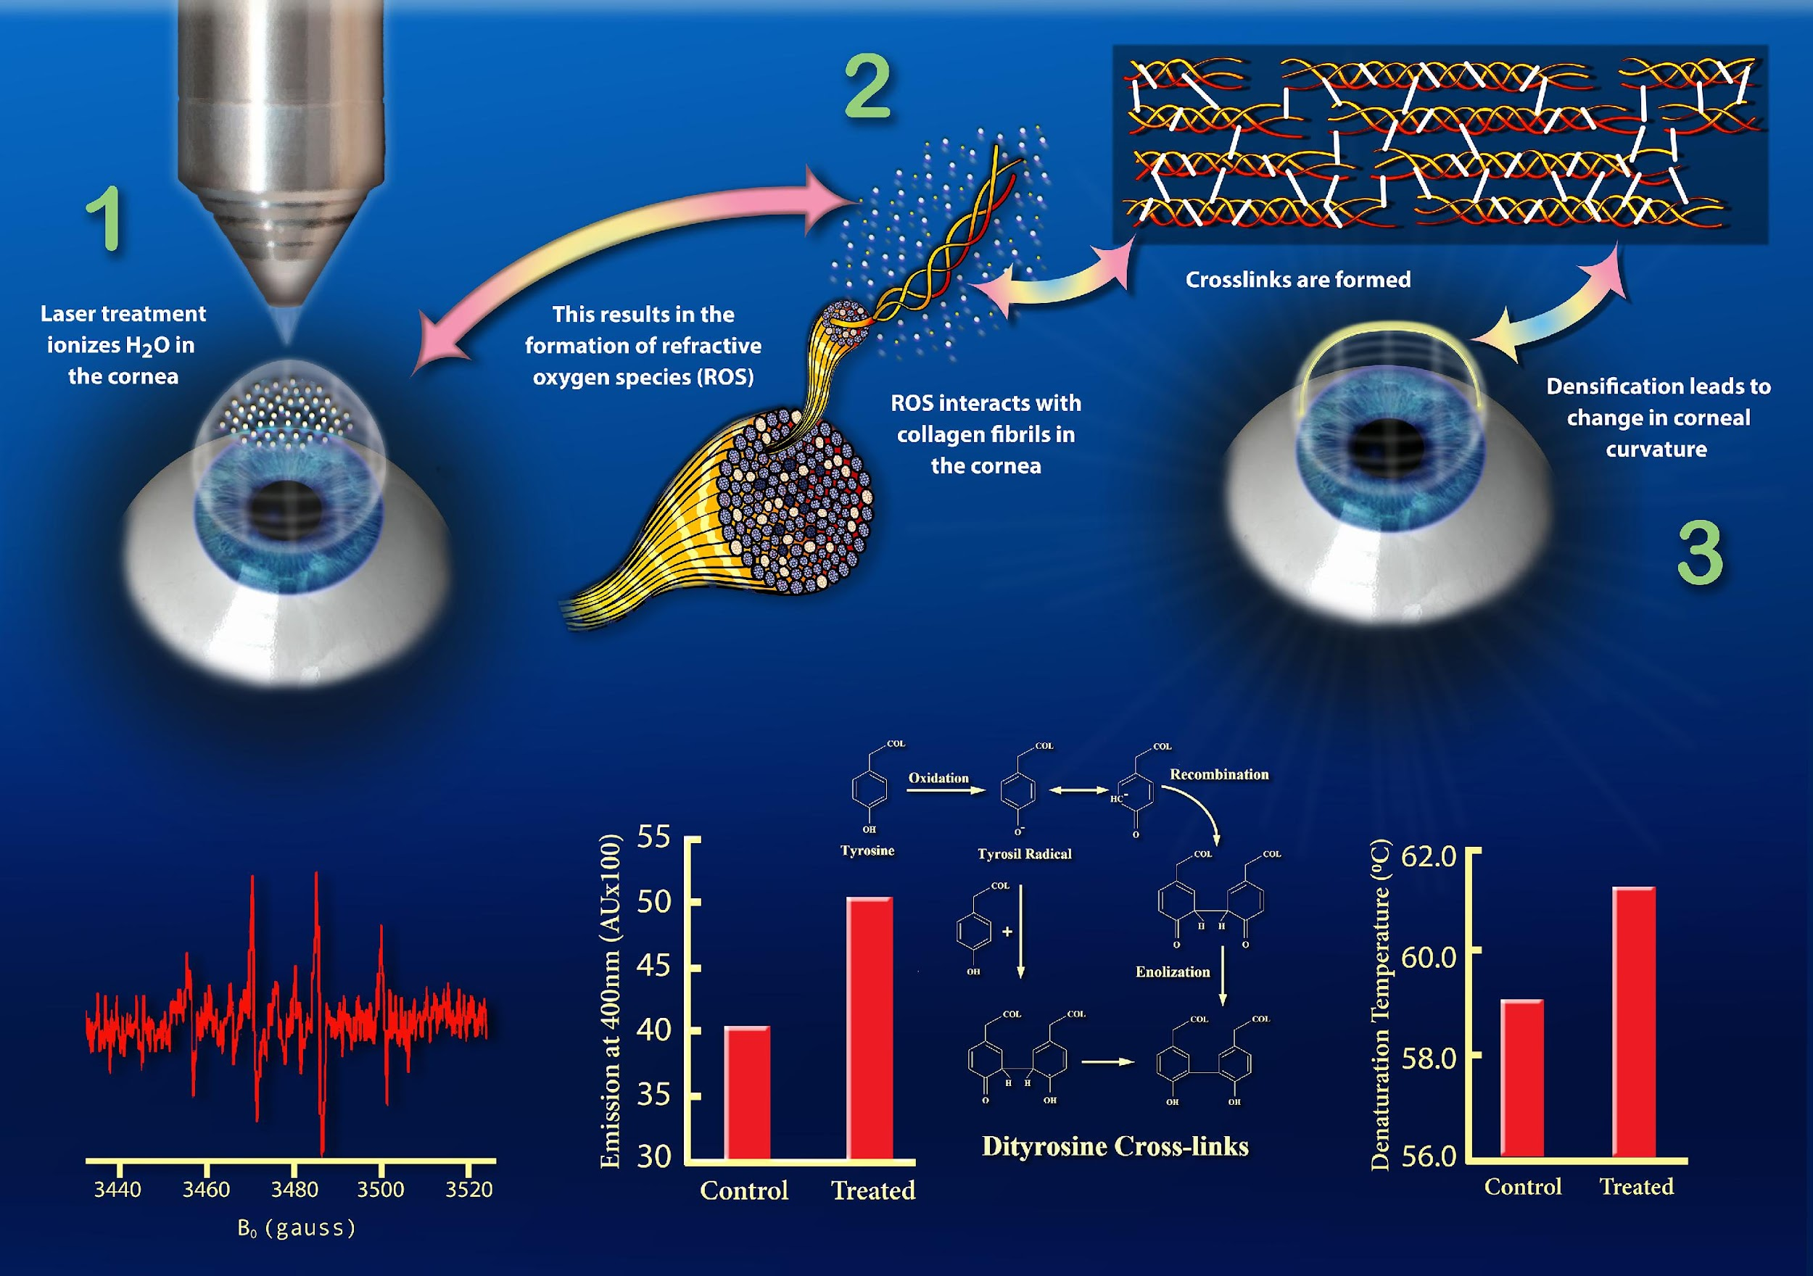
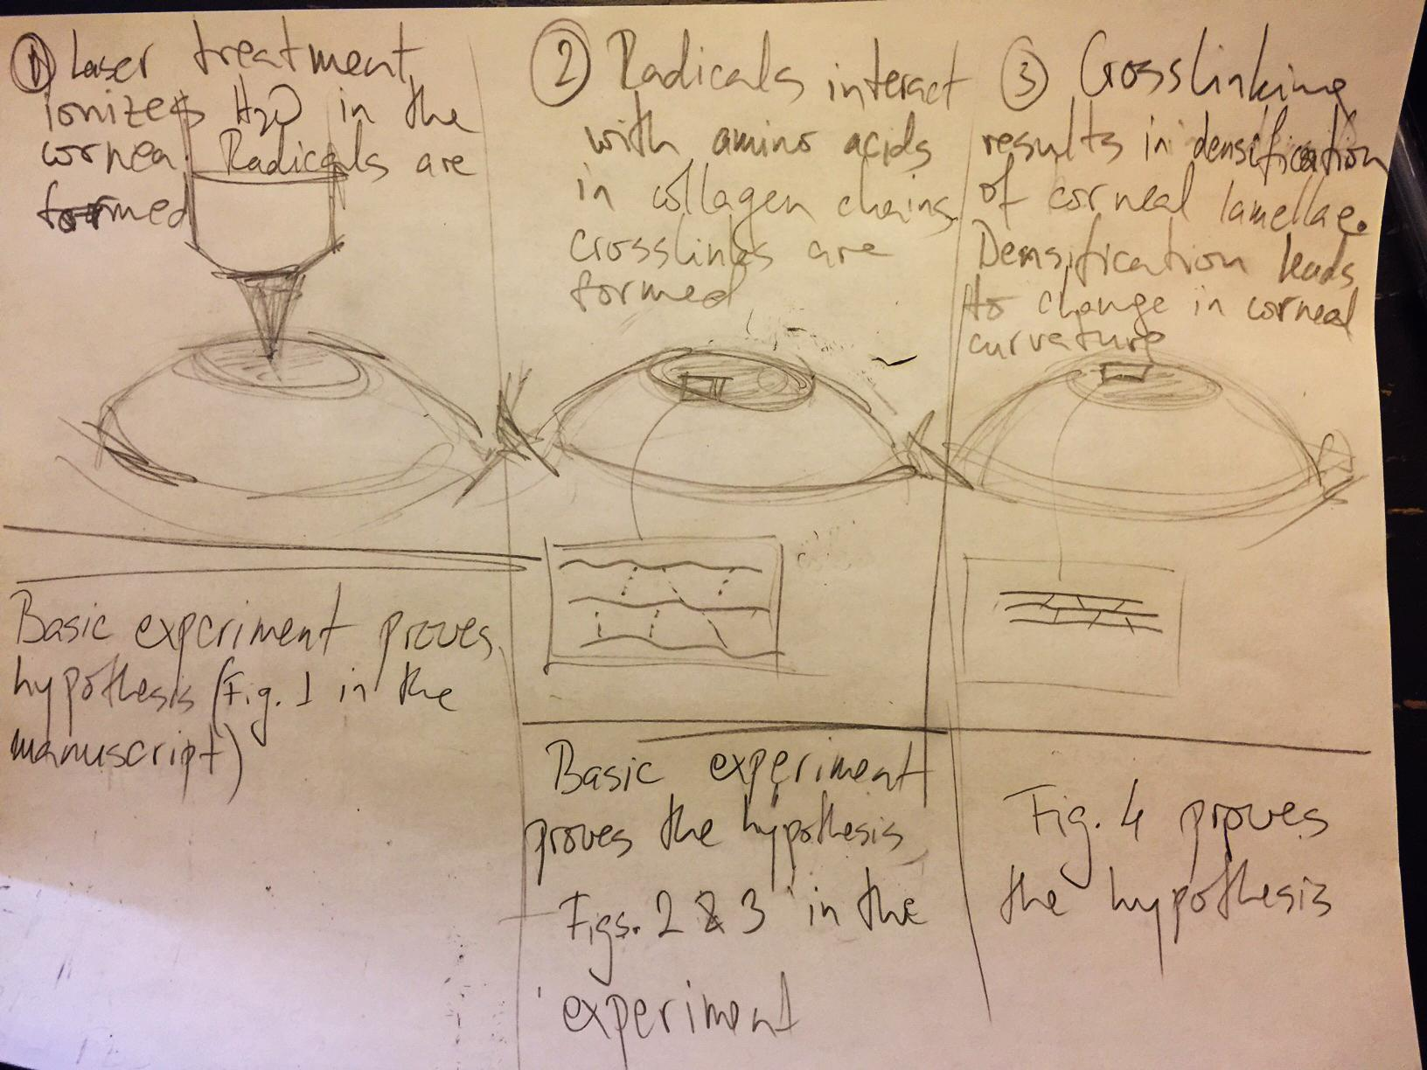
Prof. Sinisa Vukelic,
Department of Mechanical Engineering
Notes:
The sketch was organized in 3 divided columns, but I felt that it flowed better without the dividing lines and gave the numbers a striking color to better guide the viewer through the sequence
It is actually a serpentine path going from left to right on top and then zigging down to the bottom left corner

Slide 22
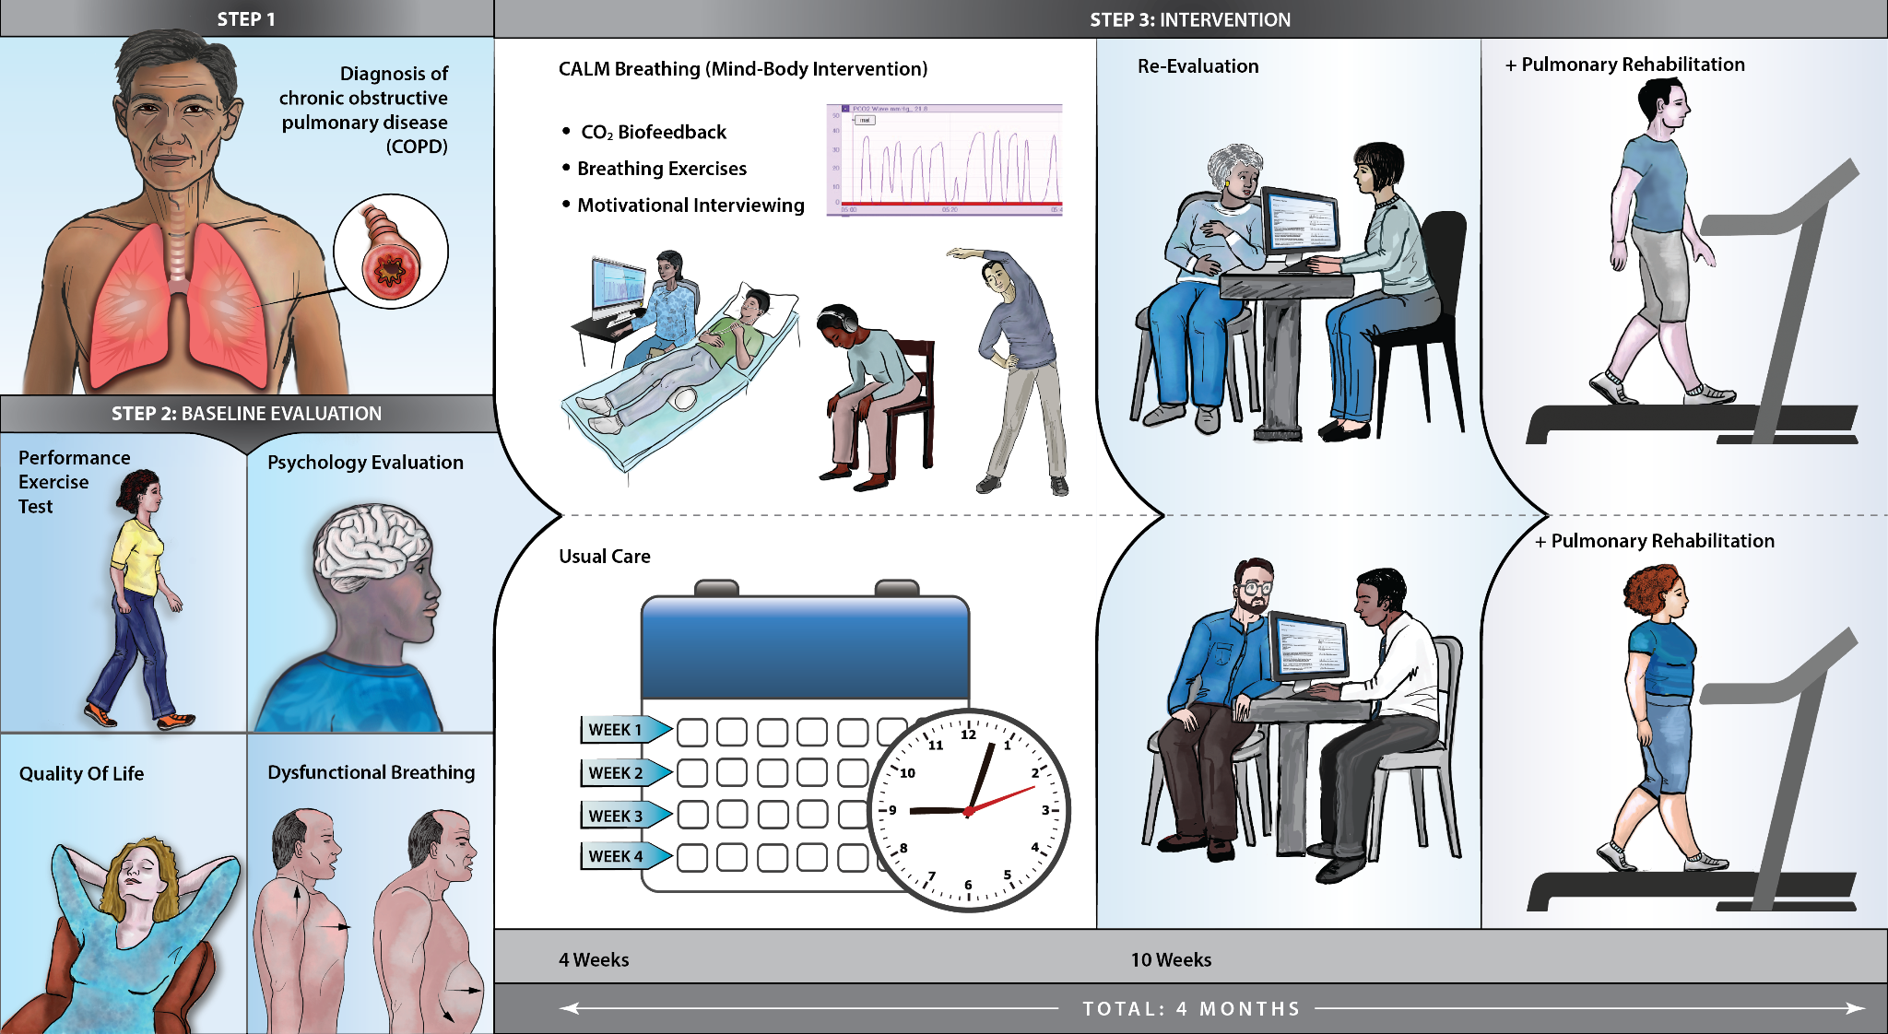
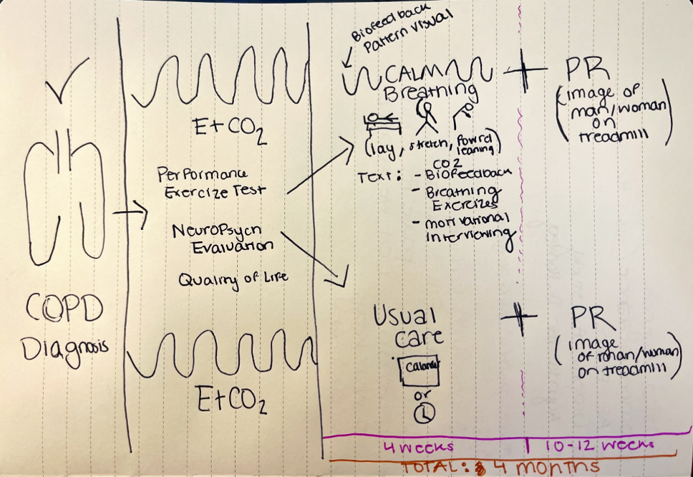
Calm Breathing
Annamaria R Norweg
Professor of Rehabilitation and Regenerative Medicine
Notes:
This is another example of a linear infographic graphic that depicts Calm Breathing Methods for rehabilitation.
Using examples of people in a graphic rather than just organs or data, often makes it more relatable.

Slide 23
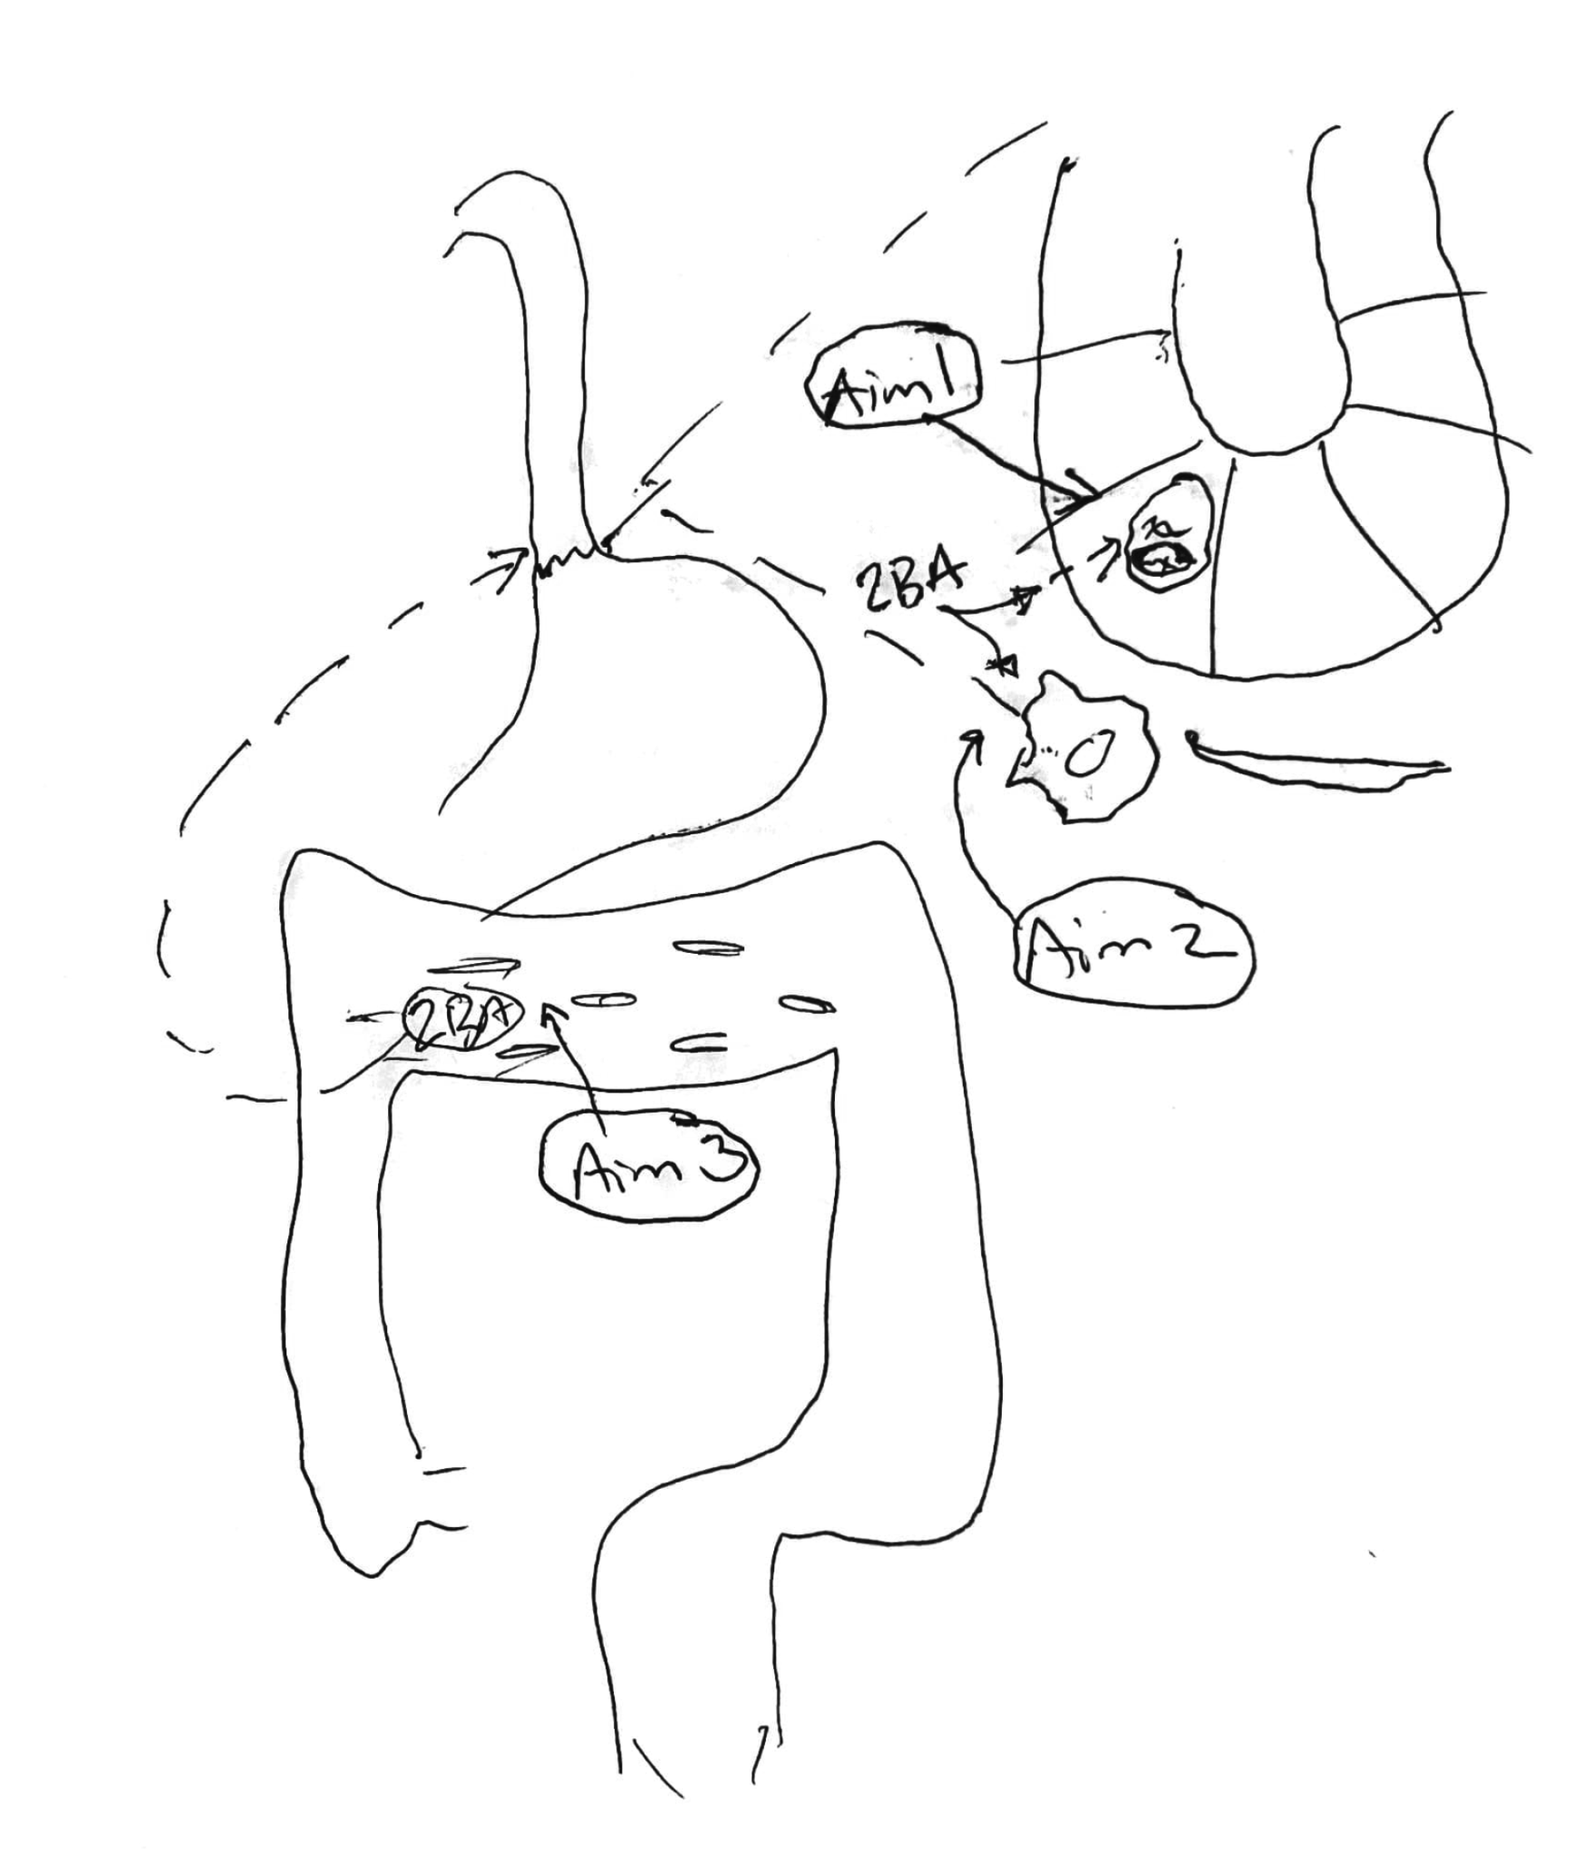
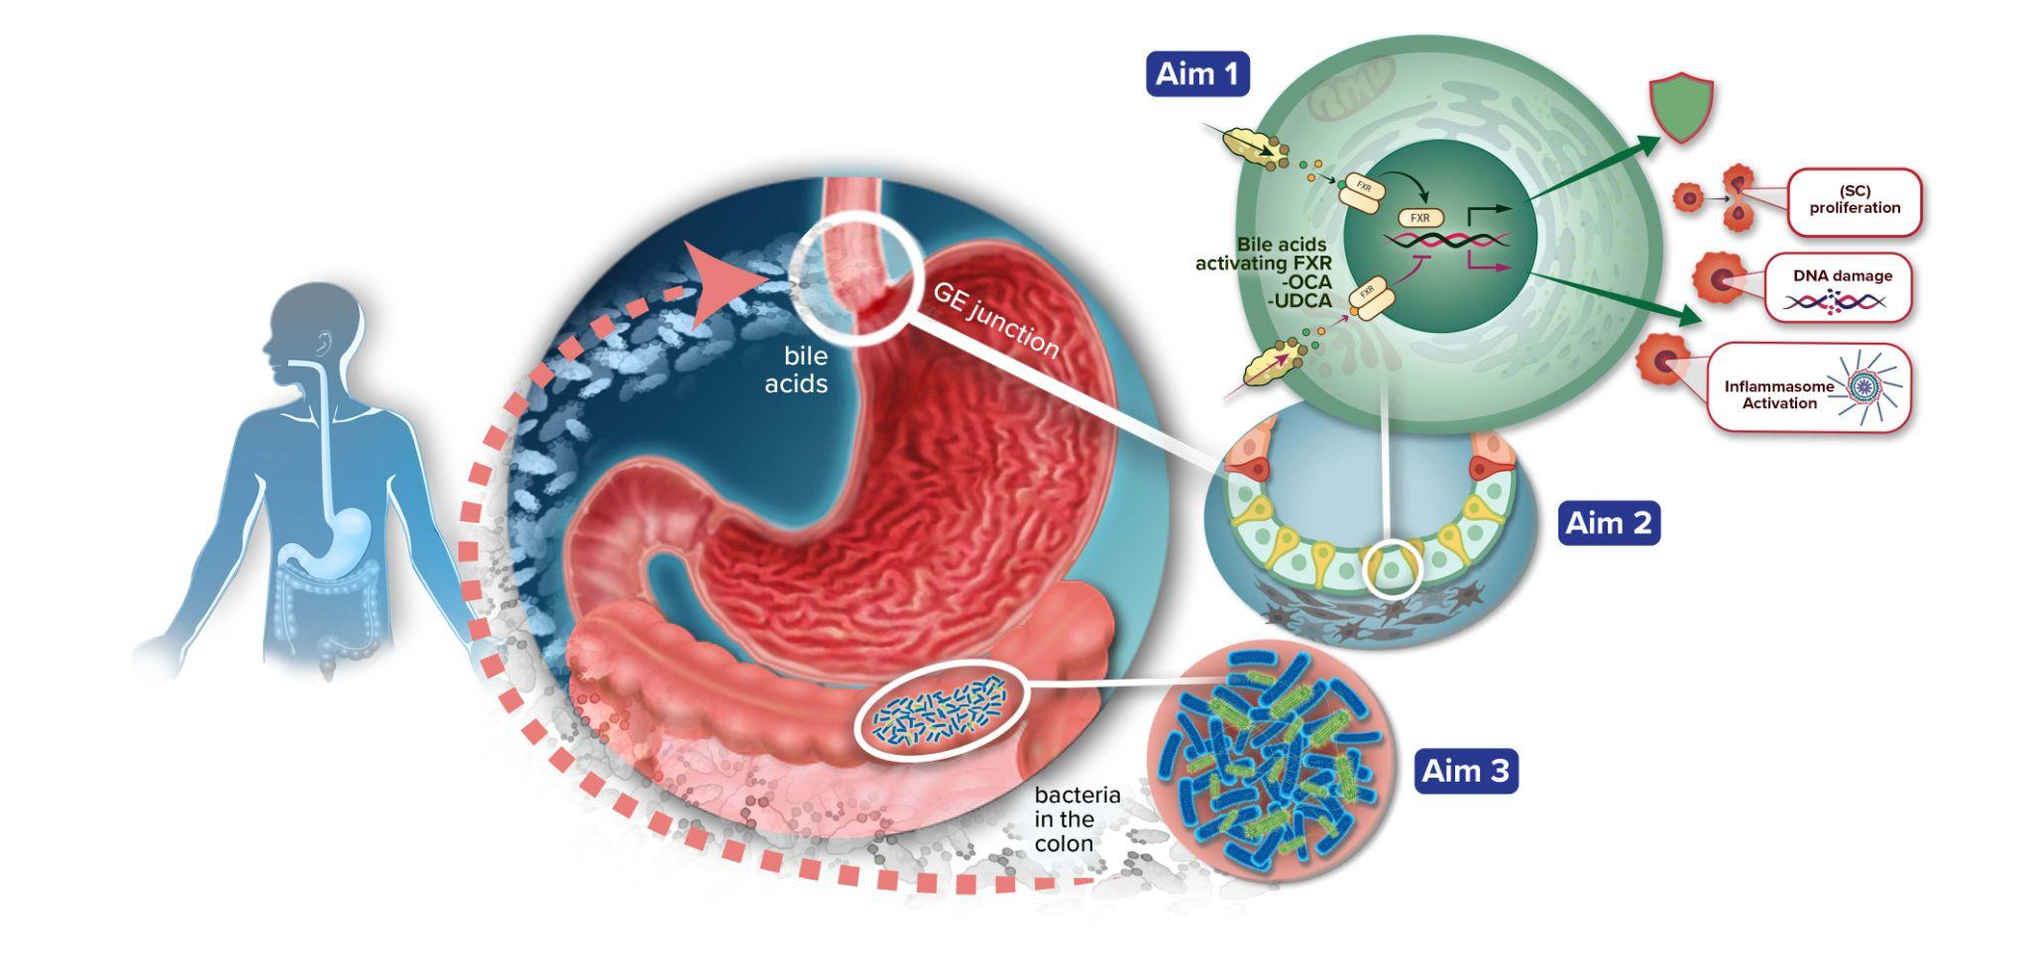
Julian Abrams, MD, MS
Professor of Medicine and Epidemiology
Division of Digestive and Liver Diseases
Notes:
this sketch is a bit of an unfinished thought--what I mean by that has nothing whatsoever to do with the lines or quality of the marks of the sketch---rather, it knows the basic idea of what it wants to say but it is unsure of how to get there in a visually efficient way.
It went through many iterations in order to become the finished product, which as you can see is quite different from the layout of the original sketch. There can be a lot of layout experimentation involved to get a graphic to work.

Slide 24
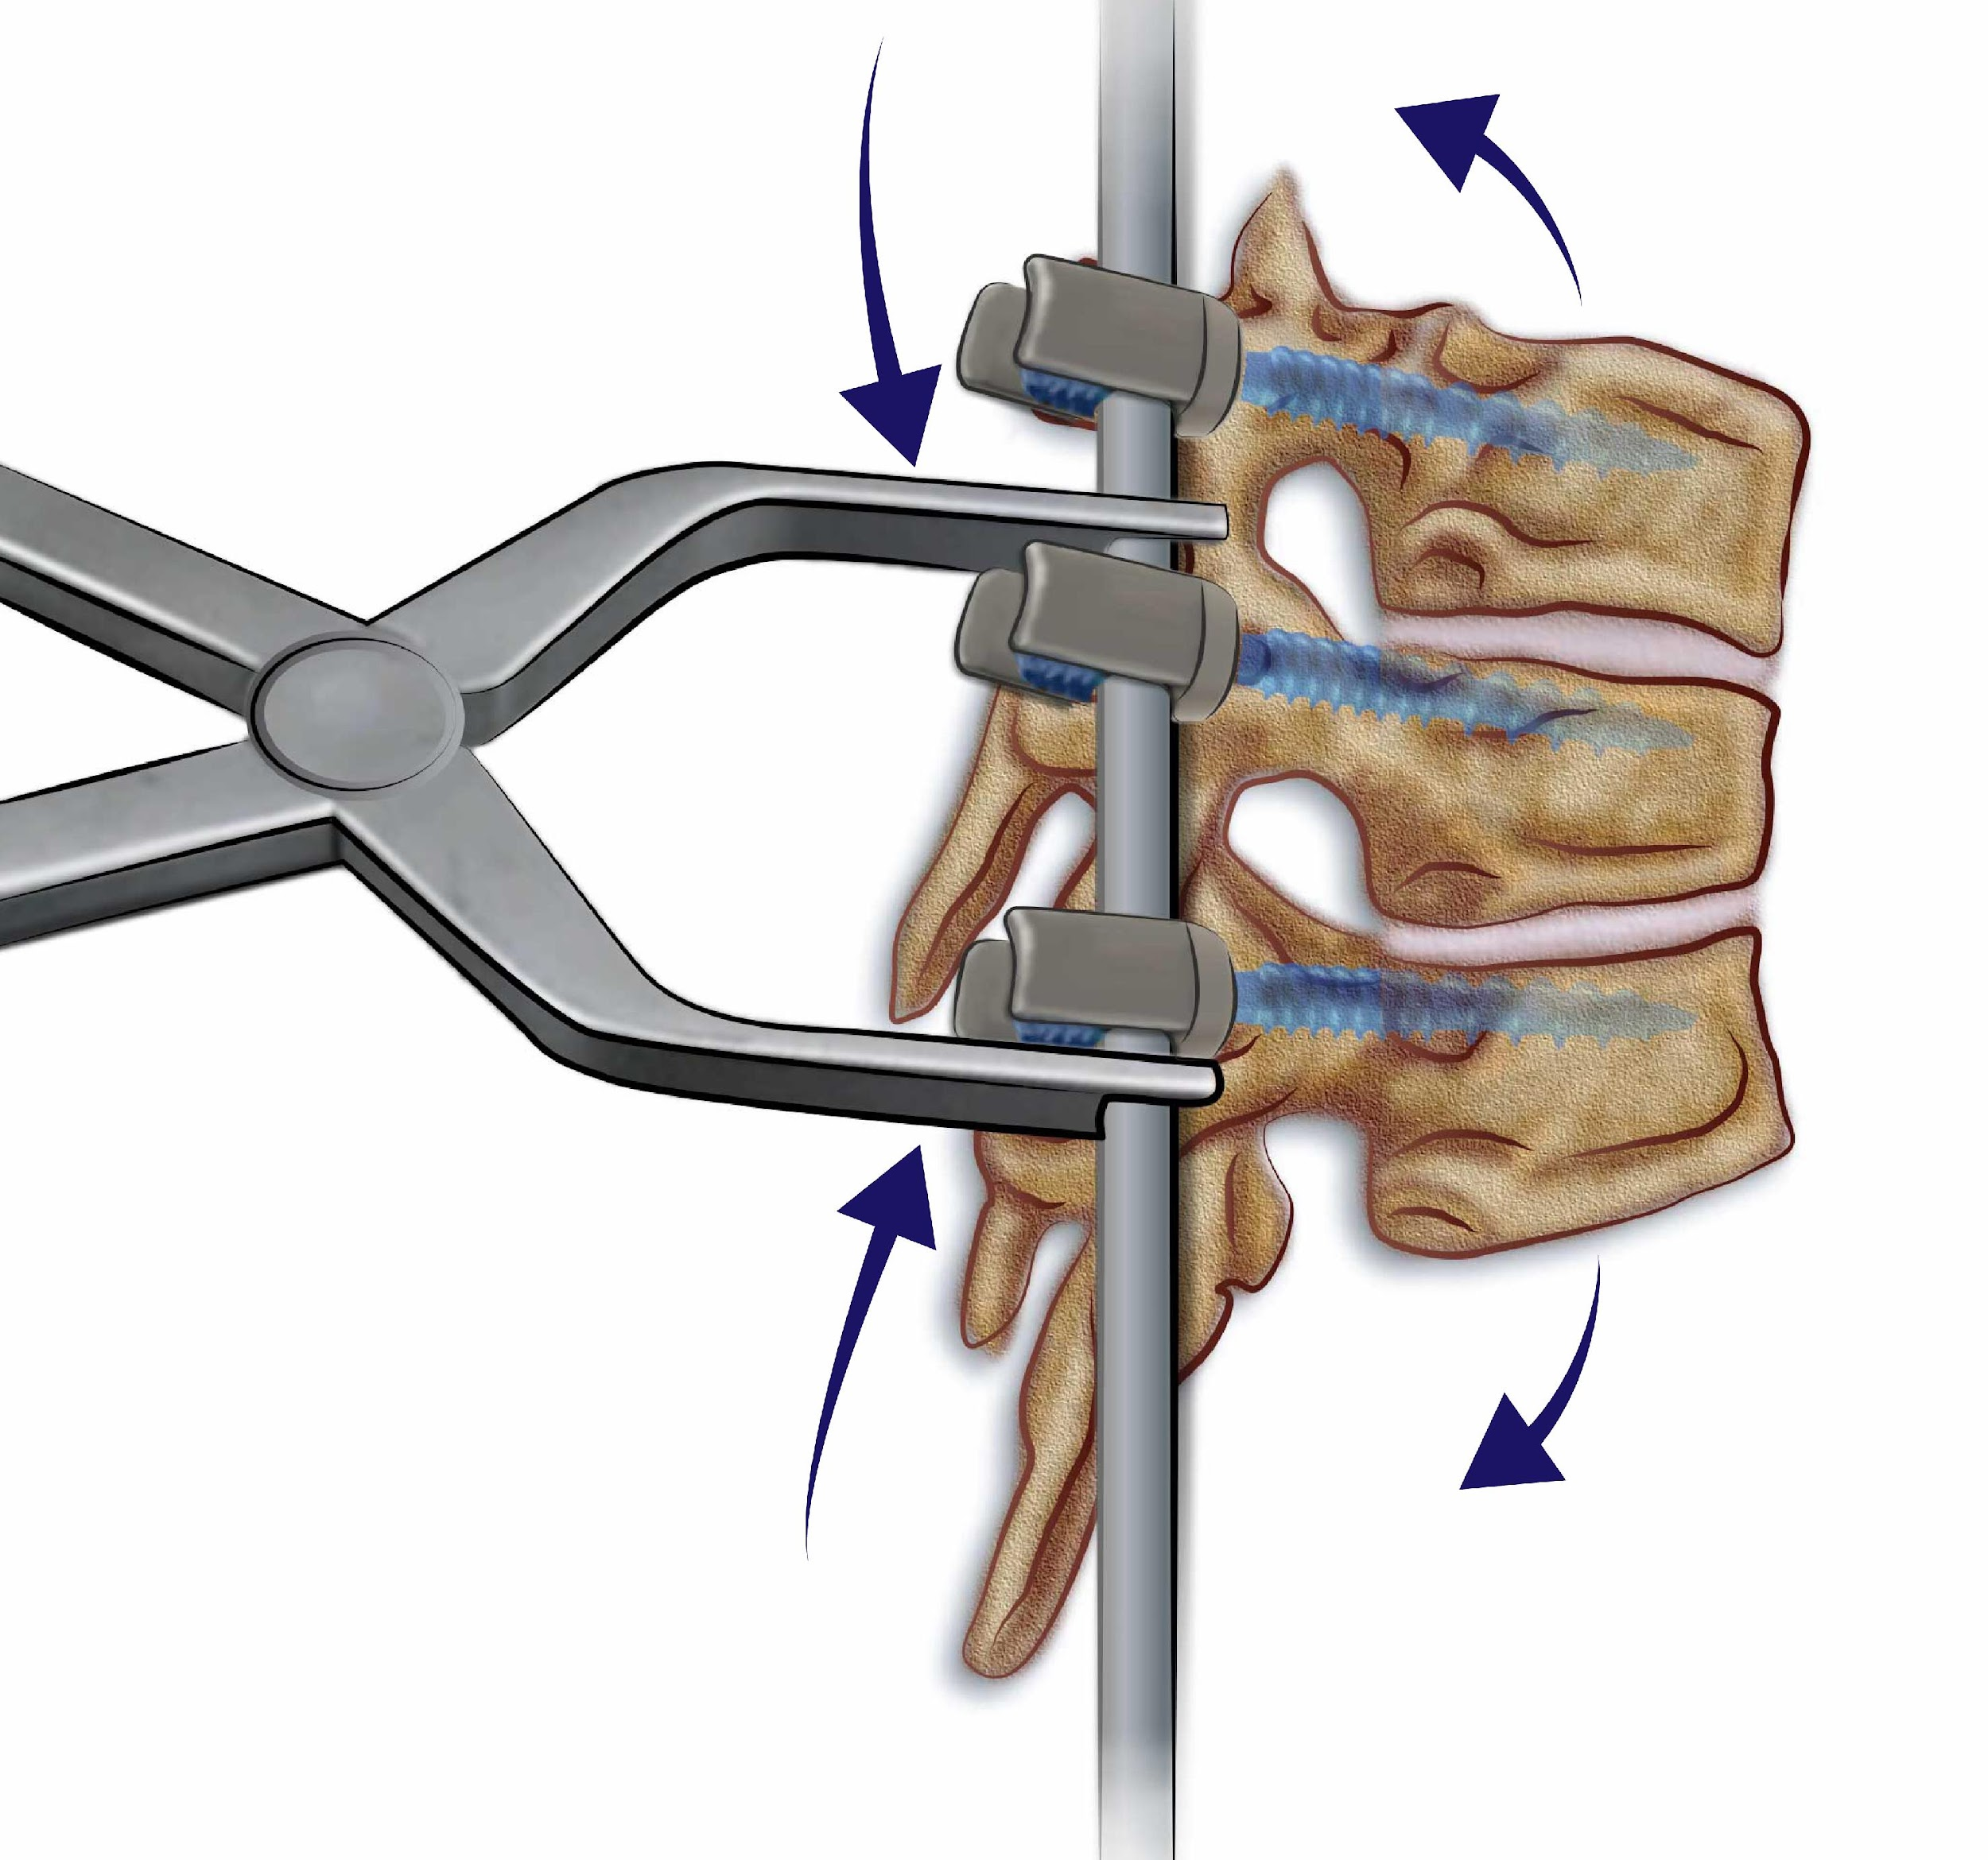
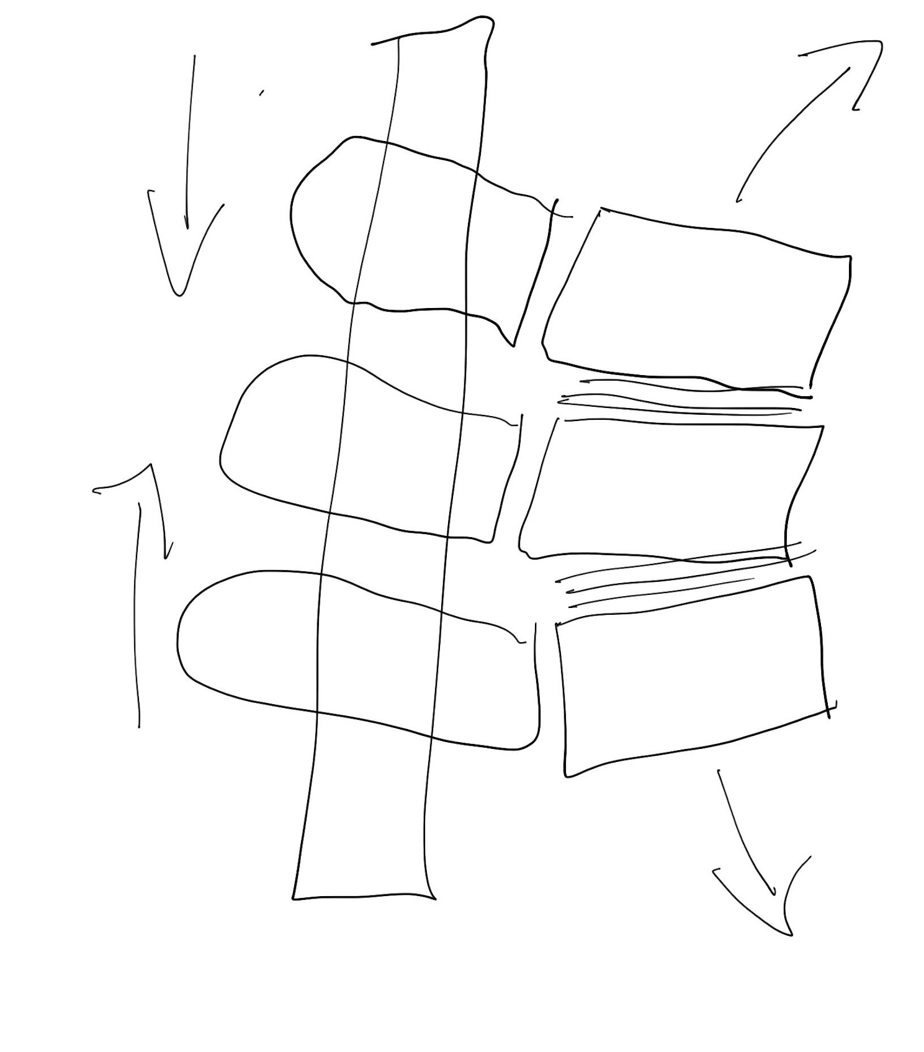
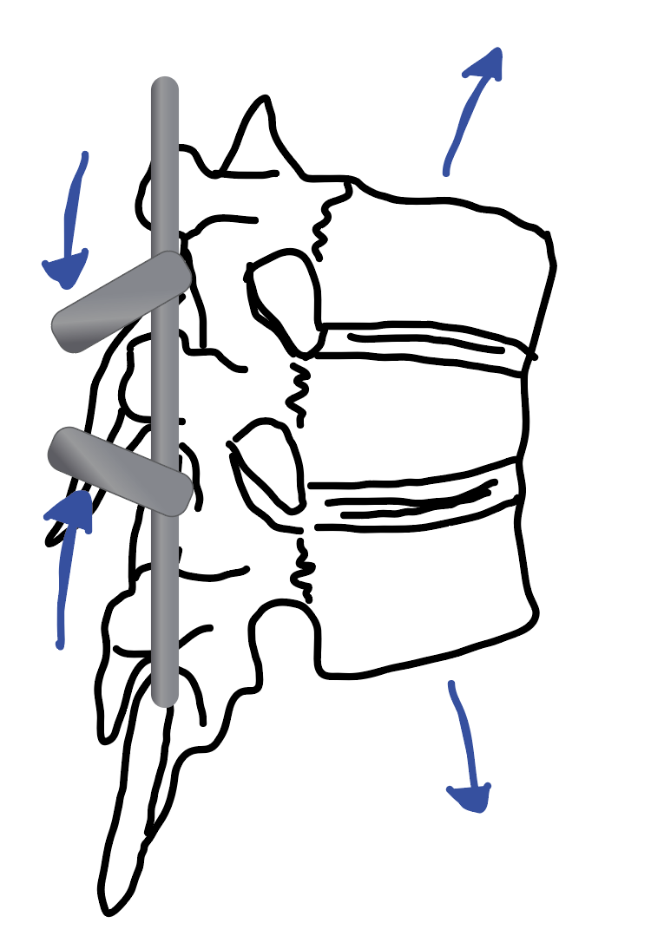
Joseph M. Lombardi, M.D.
Spine and Scoliosis Surgery
Professor of Orthopedic Surgery
Notes:
This last sketch is of spinal surgery and it required a great deal of research on my part in order to better understand the surgical tools and instruments involved. But it all began with a humble doodle that mapped out the basics of the mechanism.
In other words, preliminary sketches and doodles that an artist can springboard from are essential to generating detailed illustrations.
Next I am going to talk about developing cover art for jounals

Slide 25






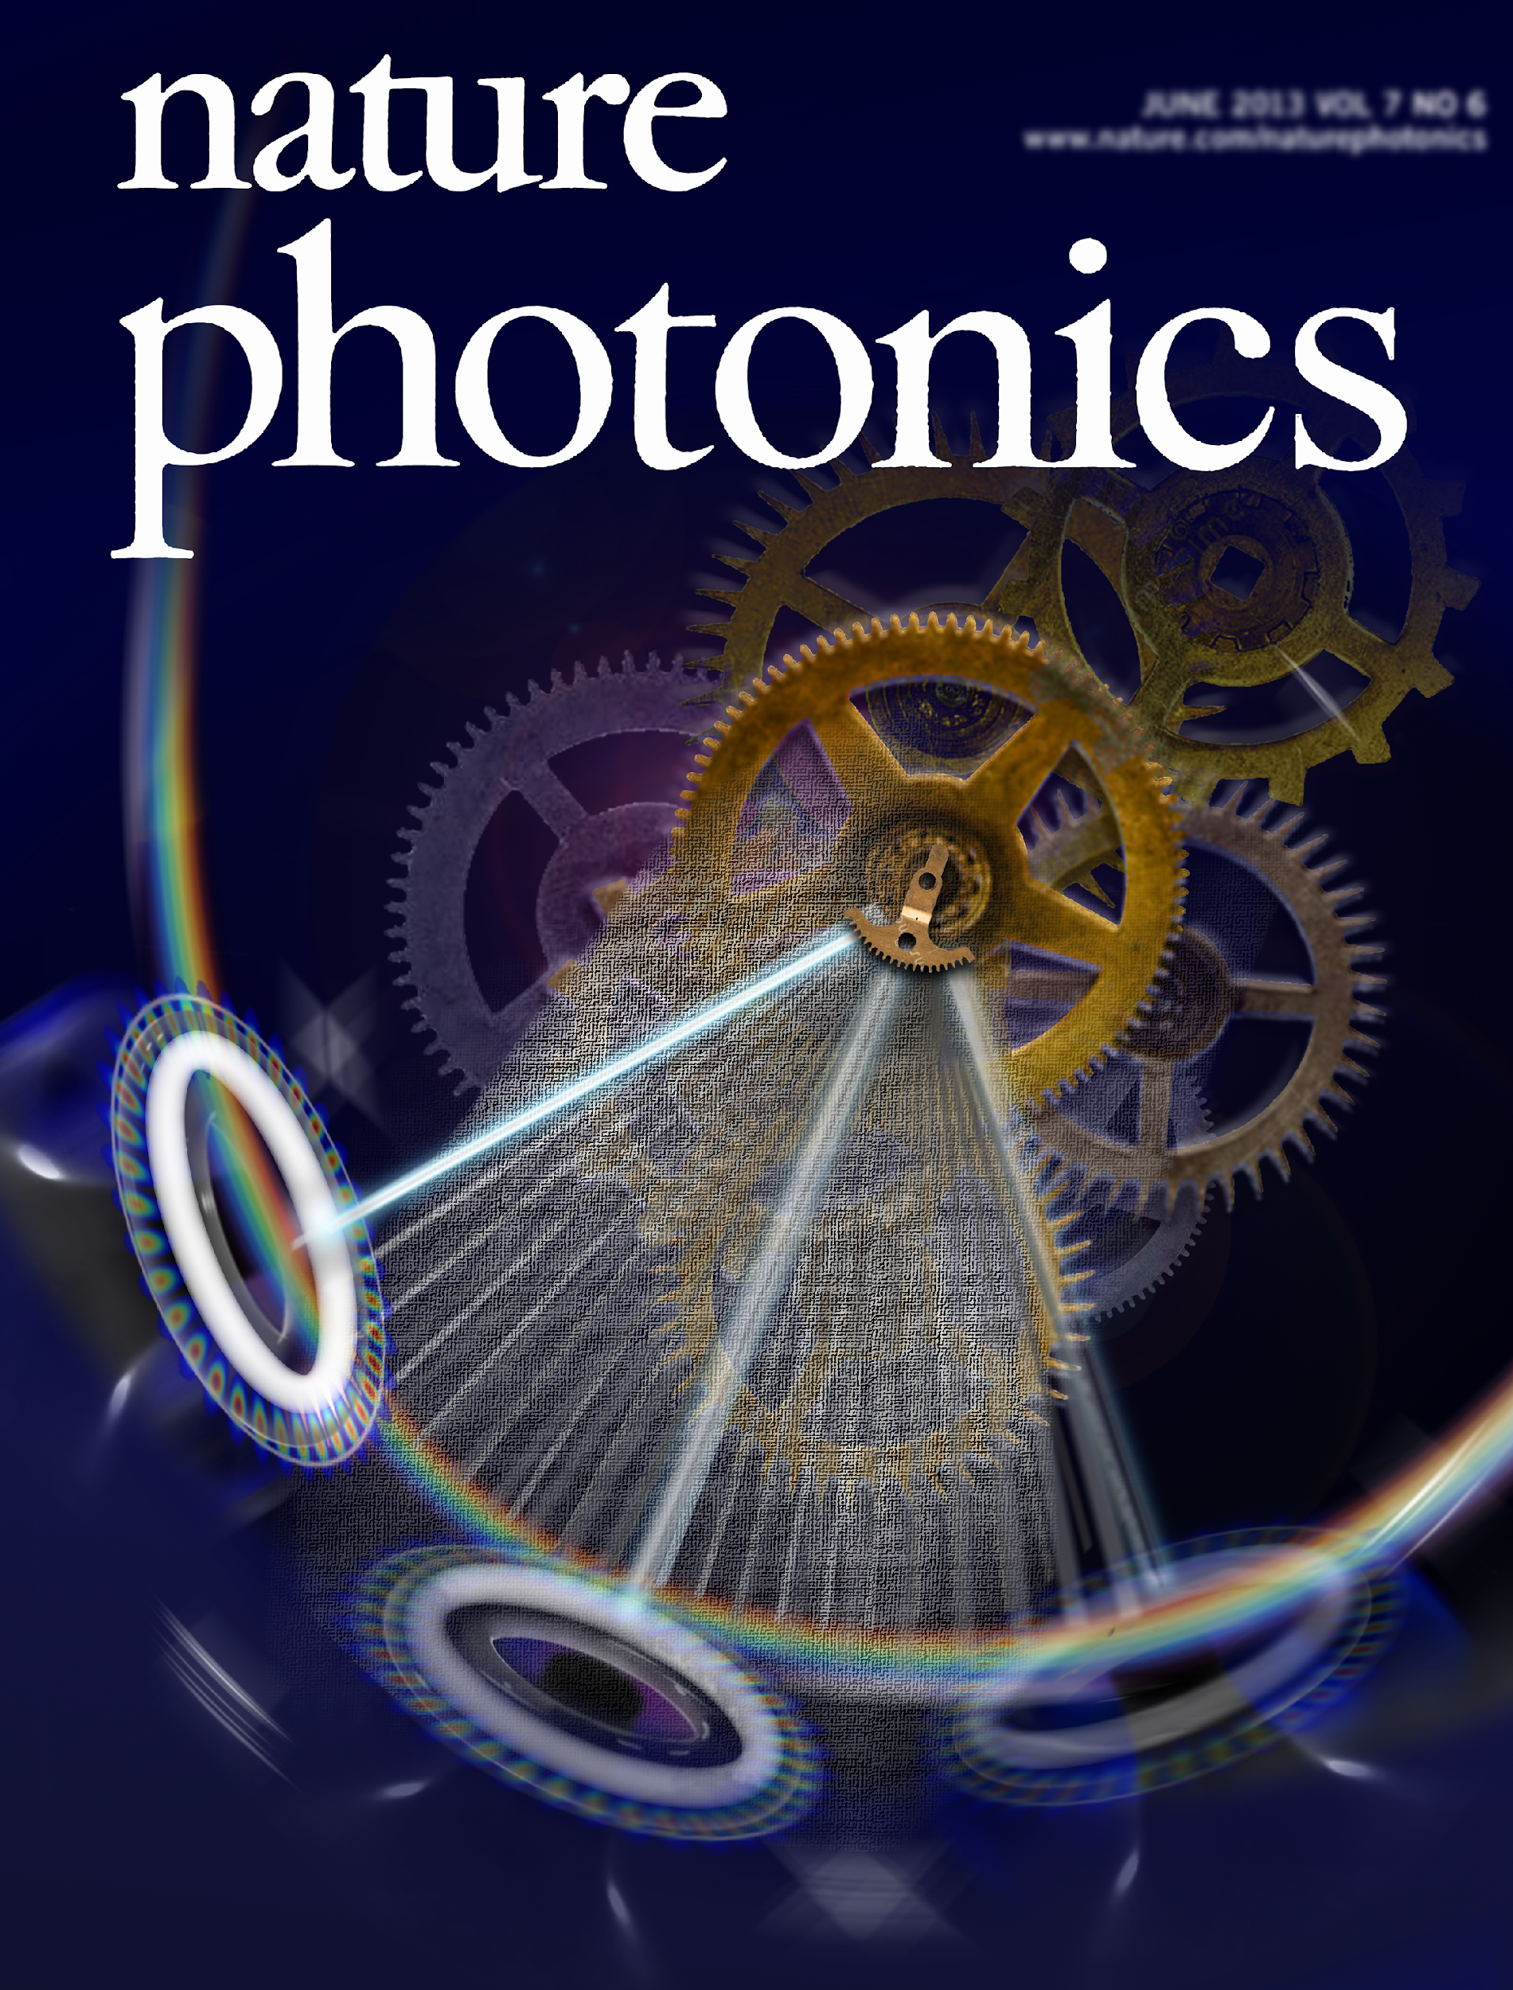

Developing cover art for journals
Notes:
Developing cover art for journals is a different process than that of creating figures
The best place to start is by reviewing the cover art of past publications in order to familiarize yourself with that journal’s particular aesthetic.
Journals have different personalities and approaches; what works for some won’t work for others.
Consider:
Is the cover art more technical and literal or more artistic and conceptual?
Is it humours? Are they using 3D elements?

Slide 26


Notes:
The following is a quick summary of the process used to create this cover art with Dr. Scott Small for Translational Science magazine

Slide 27
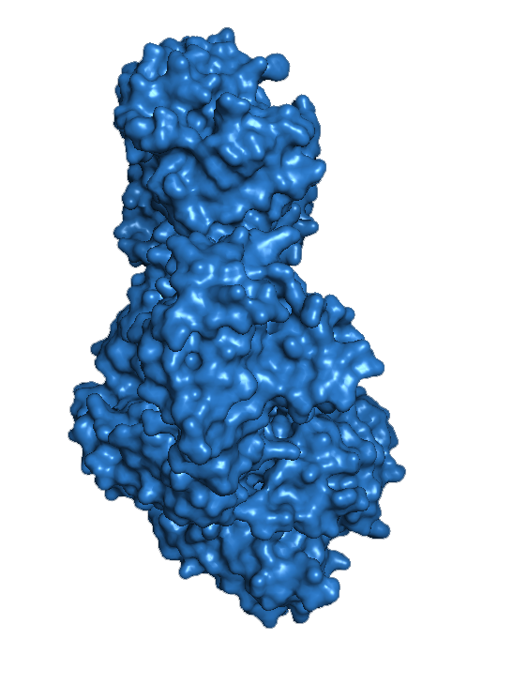
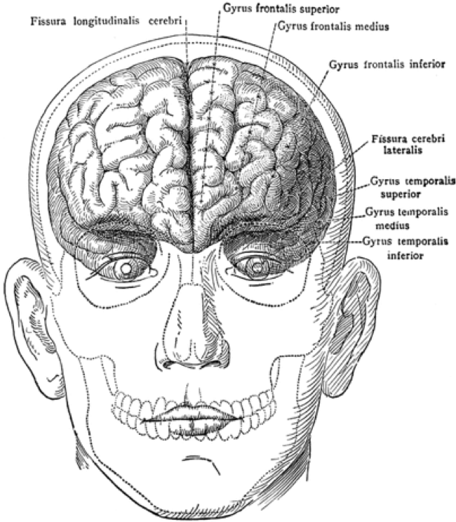
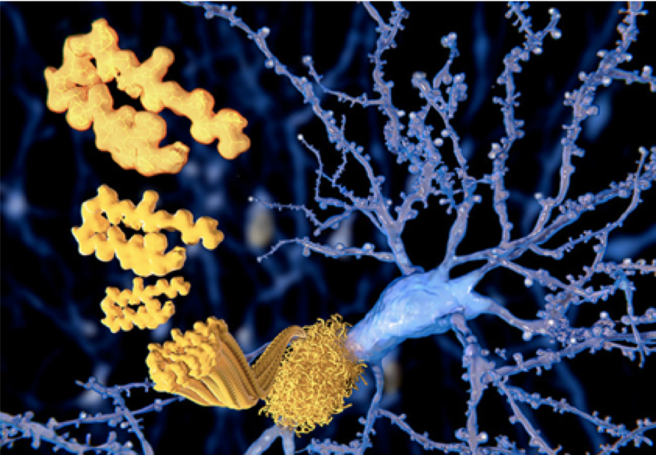


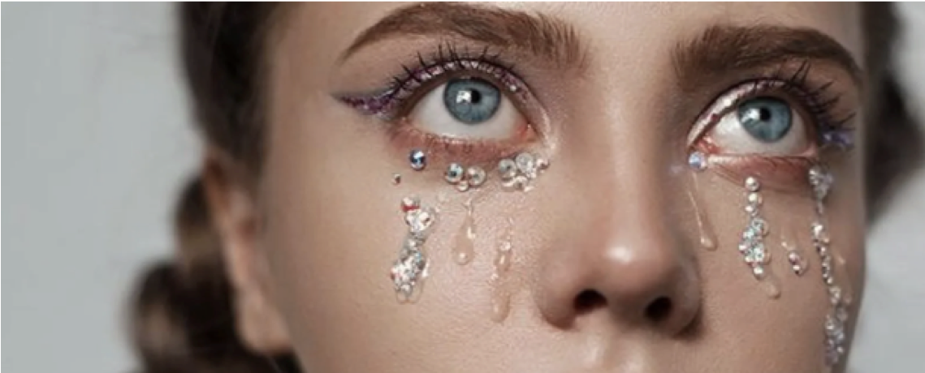
Notes:
Dr Small’s research focuses on Tau protein levels in tear fluid that are elevated in patients with neurodegeneration and have been identified as biomarkers for neurological diseases such as Alzheimer’s.
he shared these conceptual images as inspiration for cover art:
the brain
Tau proteins
degenerated neurons
clouds
tears
aging and Alzheimer patients

Slide 28
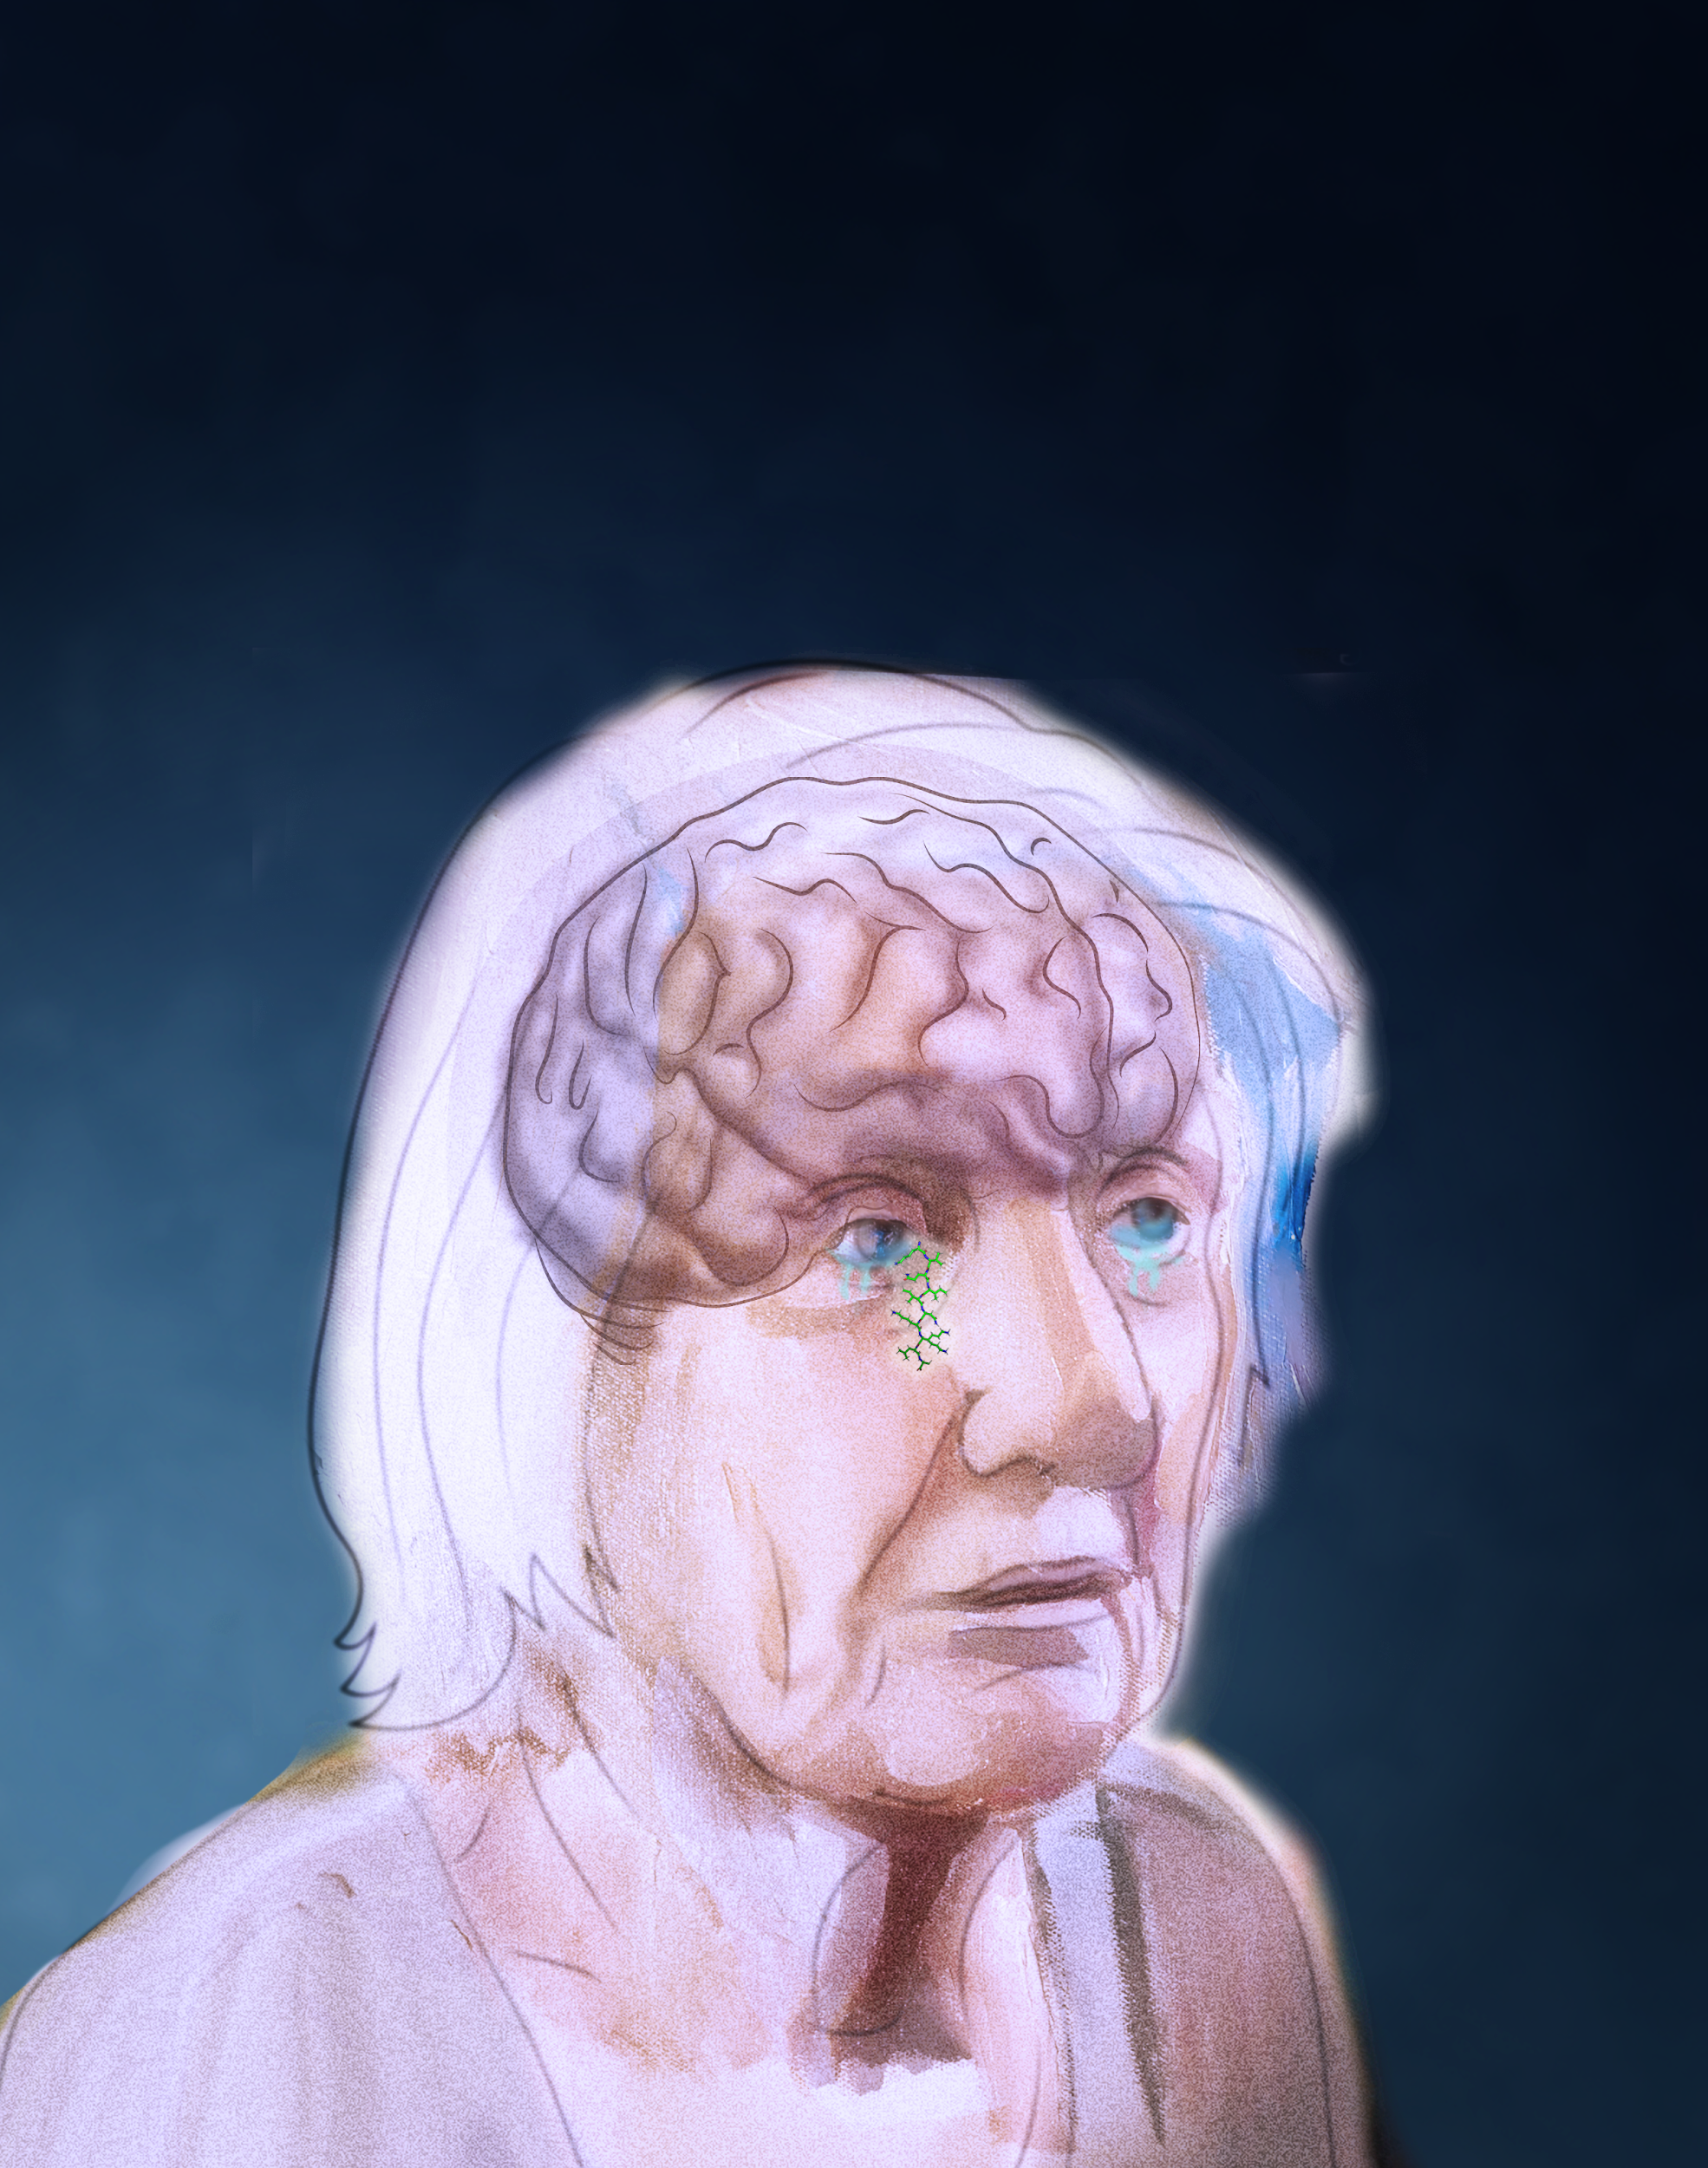
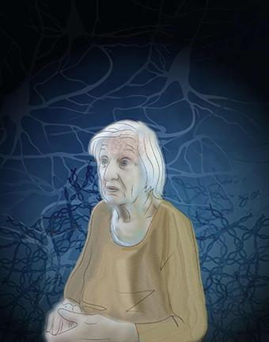
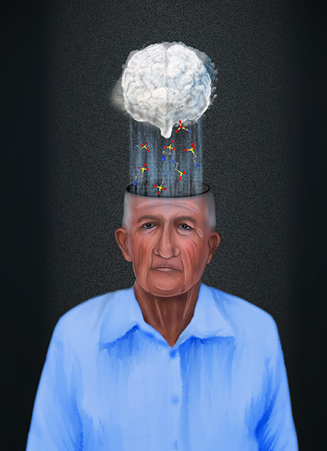
Notes:
I played with the idea of a person afflicted with Alzheimer’s crying Tau tears—
and another of a ‘foggy brain’ raining Tau proteins

Slide 29




Notes:
But looking through the past cover art for Translational Medicine, it was clear that my images were not in line with their overall aesthetic

Slide 30
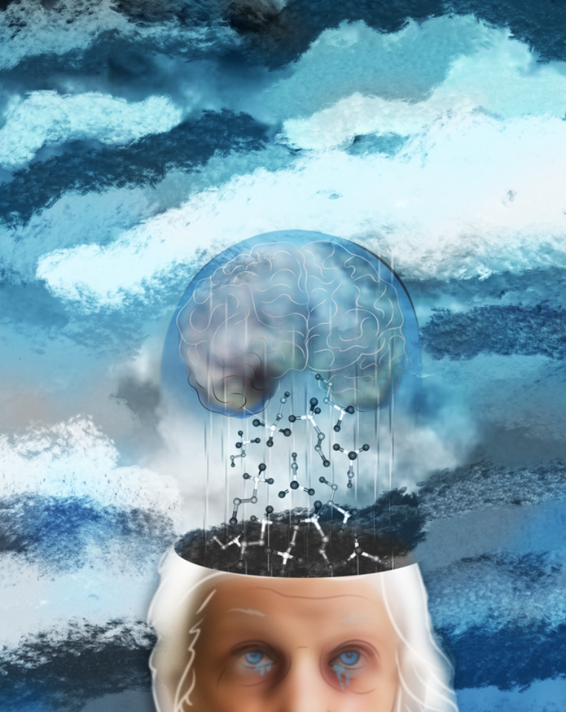
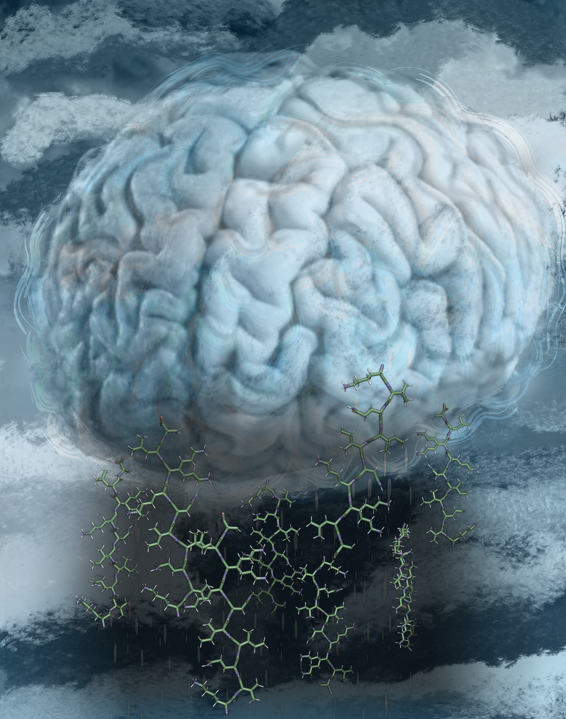
Notes:
Ultimately, we focused on the concept of a cloudy brain in a storm raining Tau proteins since it created the cleanest and most succinct visual allegory to the research.
Here are two versions using that concept.

Slide 31
Notes:
They accepted the version of the brain crying Tau and they omitted the version with the crying person—which is more consistent with the look of their past cover art

Slide 32


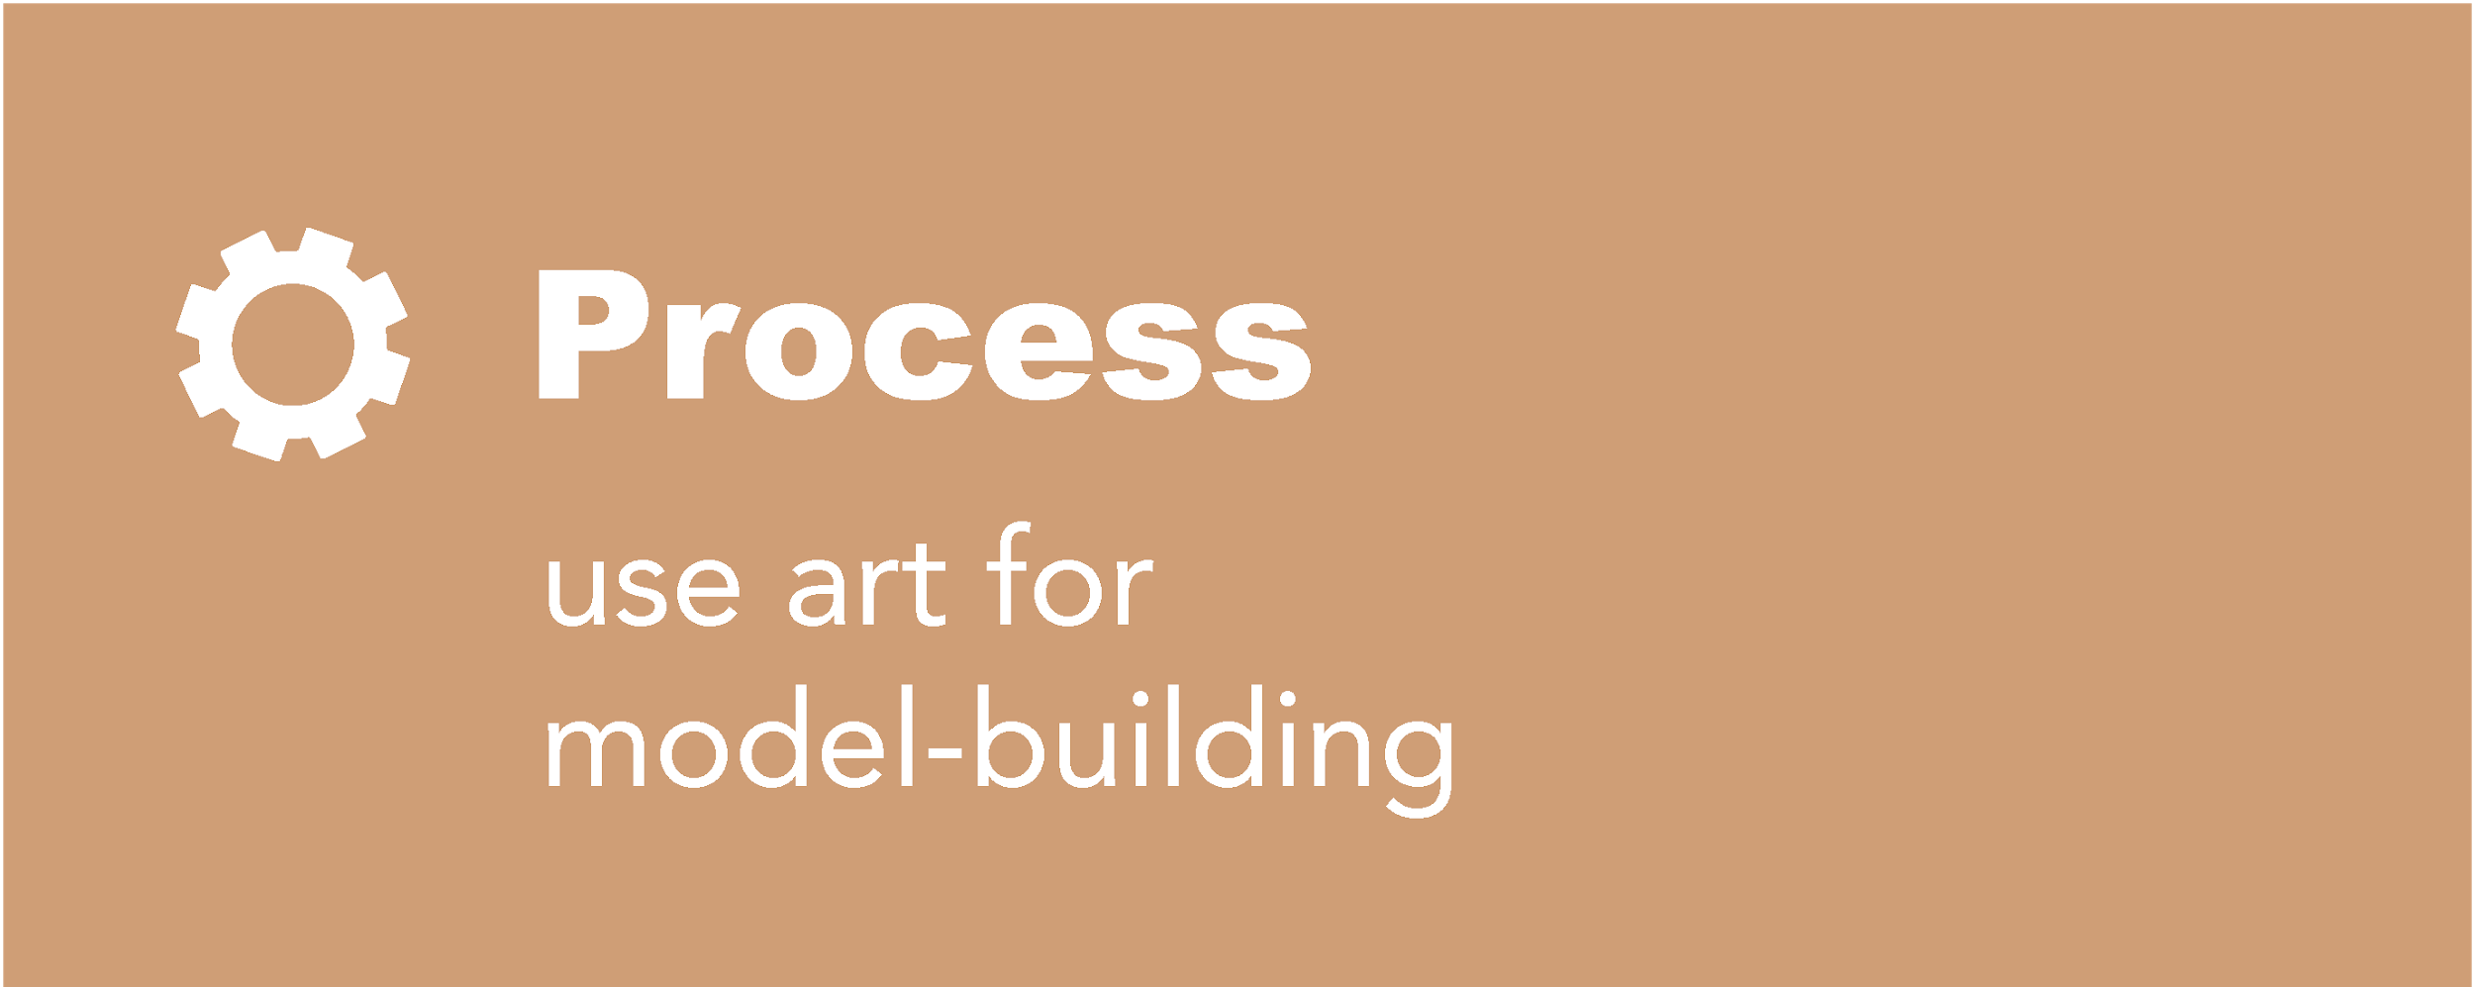

BENEFITS
Notes:
Finally, here are a few benefits of effective collaboration between scientist and artist:
Creating visuals can clarify ideas
artwork can bring in additional funding--and in some cases might even become the driver to acquiring funding.
Art can Become part of the scientific process of model-building.
And create assets that can be used to promote and communicate discoveries on multiple platforms

Slide 33

INCLUDE ART
AT THE START!
Resources for science graphics:
Nicoletta (Niki) Barolini
nb2367@columbia.edu
Notes:
As with all things, the more attention and time given to its development the better the results, so include art at the start!
Feel free to reach out to me if you would like to discuss creating a science illustration or graphic!

Slide 34
Linear
Circular
► Path
Convergent
Radiating
Serpentine
Notes:
As in a story, there is a narrative, or a distinct path from entry to exit point.
Clear paths are crucial for directing the flow of information.
Here are a few examples of common paths:
Linear
Circular
Convergent
Radiating
Serpentine

Slide 35
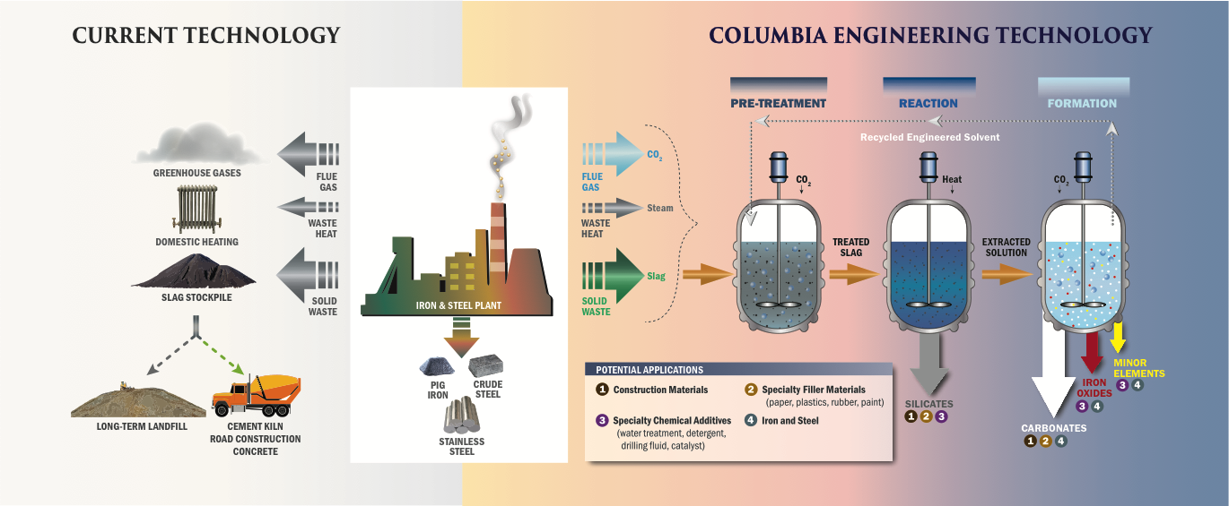
Enter
Exit
Notes:
The graphic about recycling slag was made to communicate the process to a general audience so it keeps complex scientific details to a minimum. The entry point is on the left, were the viewer is then guided linearly through the recycling process in a logical manner.

